Slide 1


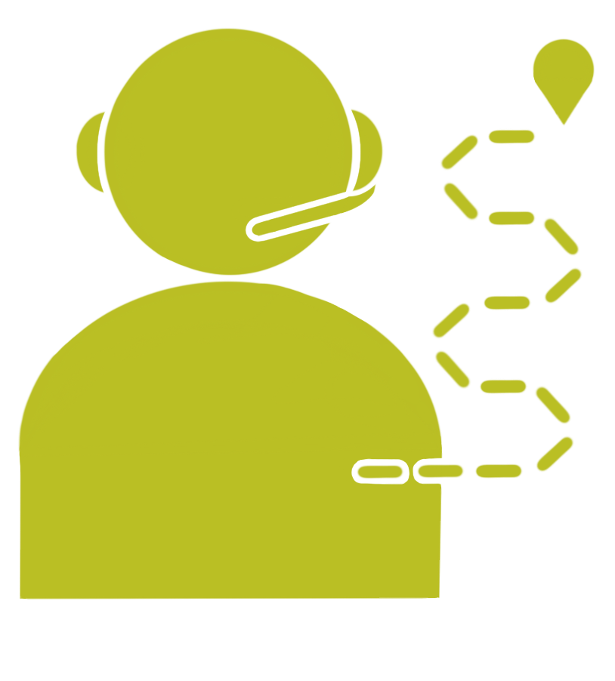
Unit 3 Lesson 8 - Wrap Up
Pair Programming: a collaborative programming style in which two programmers switch between the roles of writing code and tracking or planning high level progress

