Slide 1

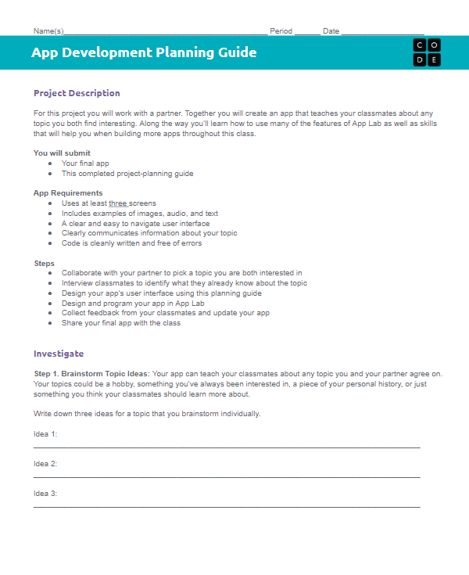
Unit 3 Lesson 9 - Activity
Designing an App Part 4
You should have:
App Development Planning Guide

