Slide 1
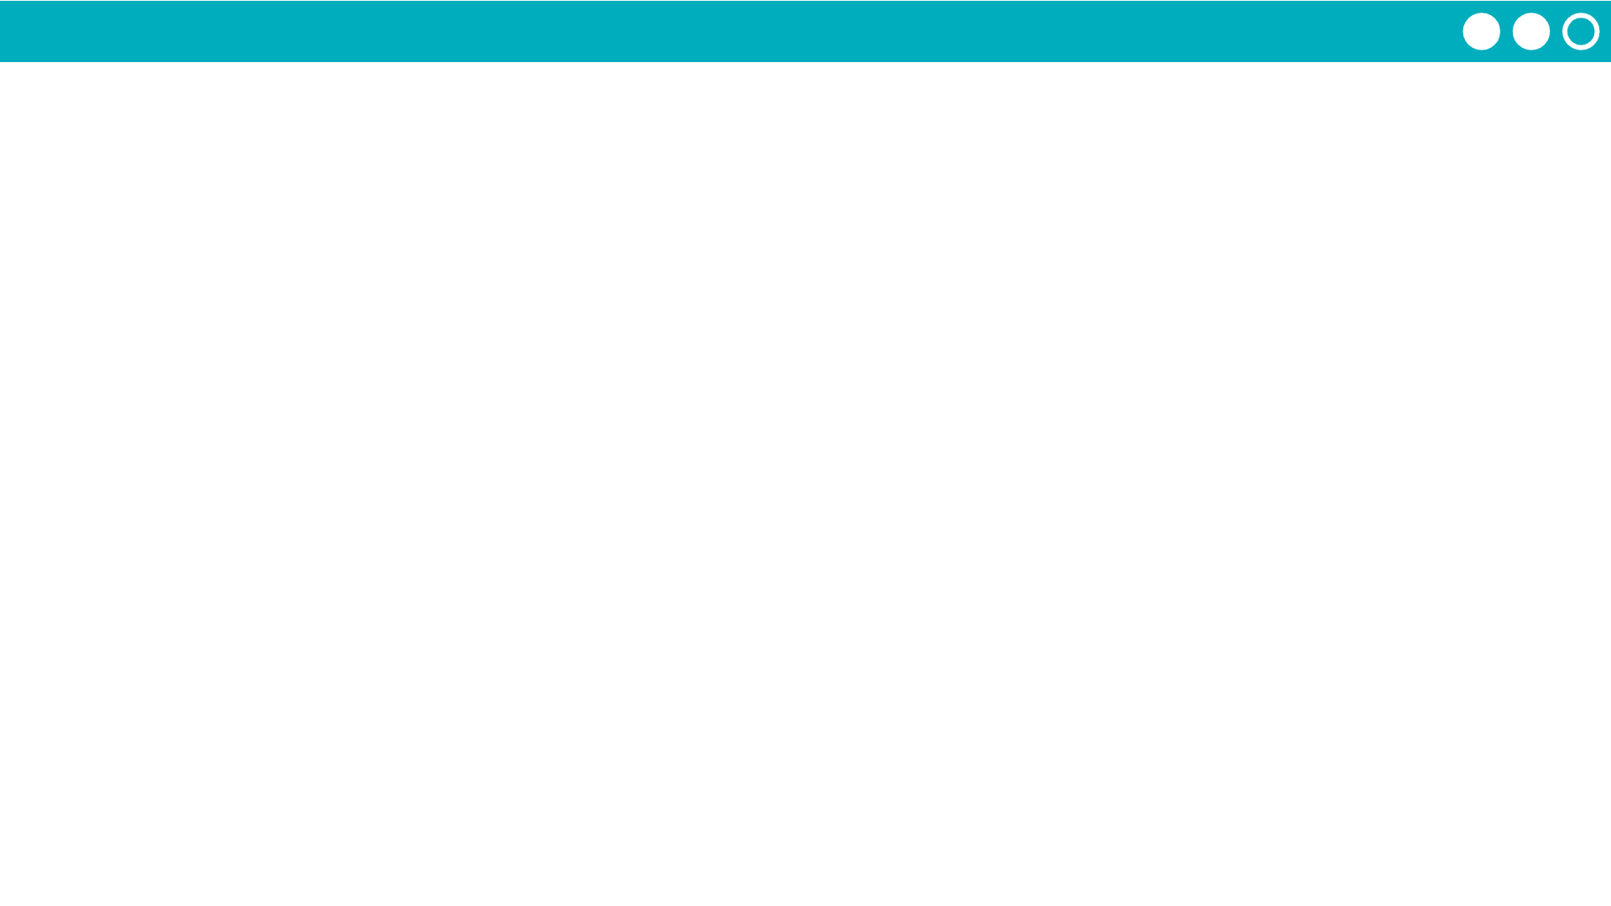
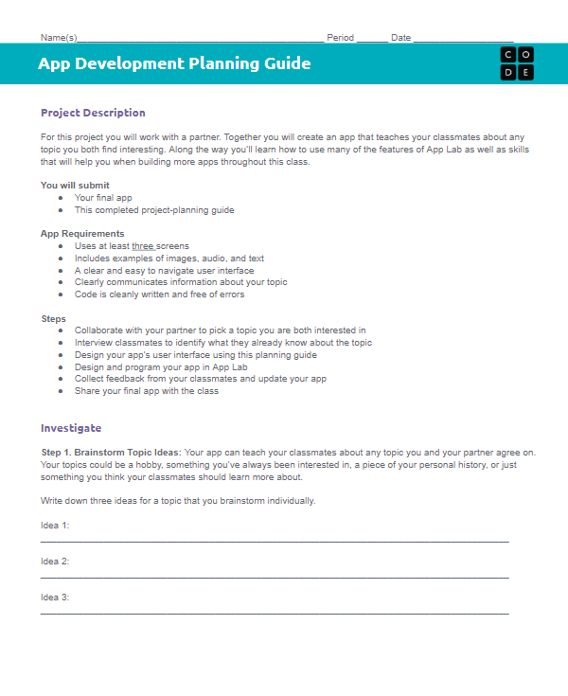

Unit 3 Lesson 9 - Activity
Step 6:
Testing and Feedback
Name | Things that could be improved based on watching them use the app | Improvements this person recommends

