Slide 1

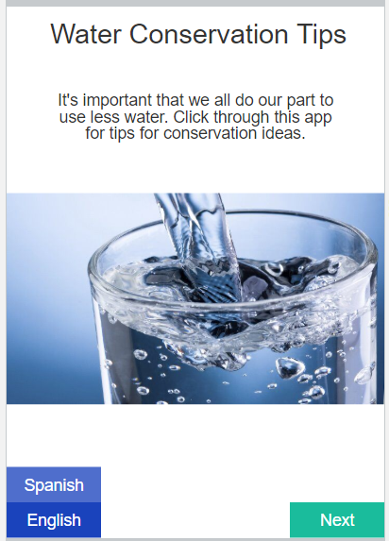
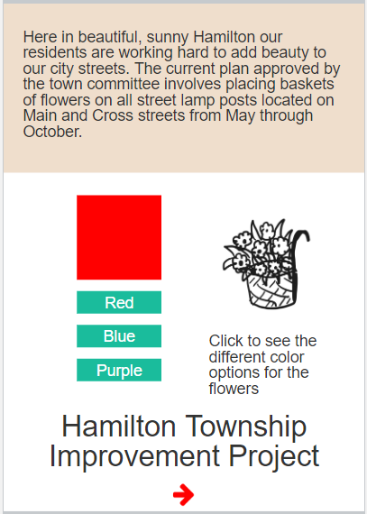
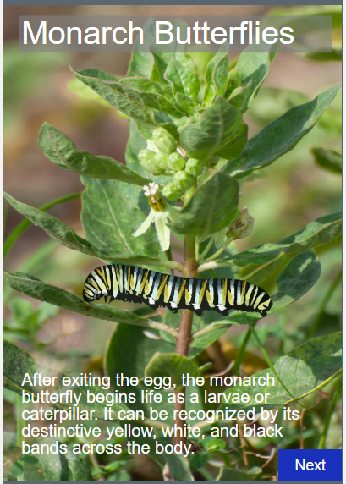
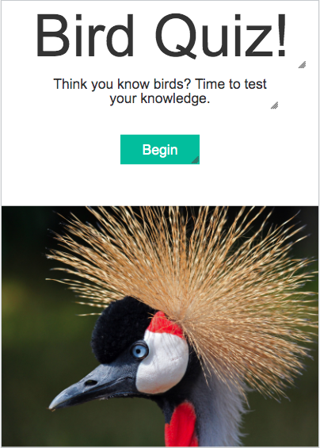
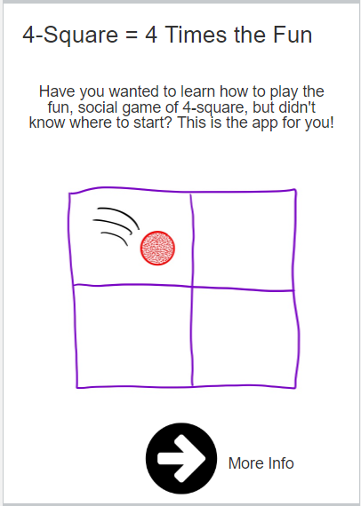
Unit 3 Lesson 1 - Activity
App Investigation
For this part, start at Level 6
Do This:
With your partner, take another look at the sample apps you explored before by navigating to the App Investigation starting at Level 6. Consider what the inputs and outputs are for the apps.
Note these down in your journal.

