Slide 1

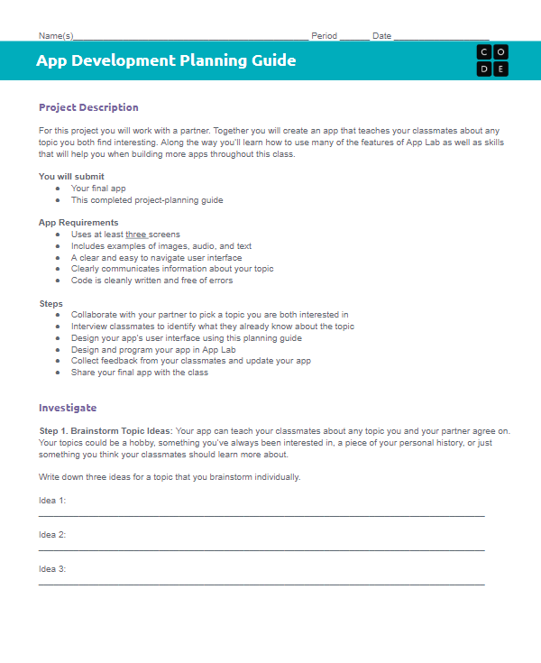
Unit 3 Lesson 9 - Wrap Up
Step 7:
Pick Improvements
Step 7. Pick Improvements: Pick at least one improvement you plan to make to your app based on feedback you collected from your classmate.
Improvement 1: __________________________________________________________________________________________________________________________________________________________________
Improvement 2 (Optional):
__________________________________________________________________________________________________________________________________________________________________

