Slide 1
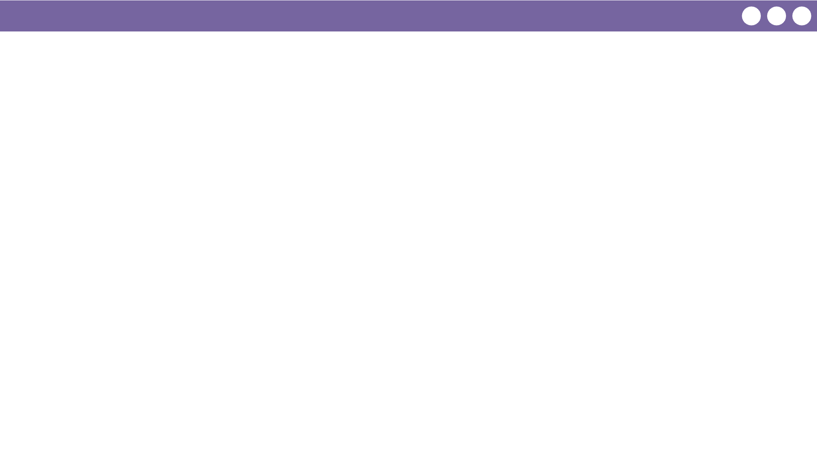
Unit 3 Lesson 9 - Wrap Up
Prompt:
Why is it important to get feedback from others while building your app?
What is the value of getting this feedback even if you aren't finished with your app?

