Slide 1

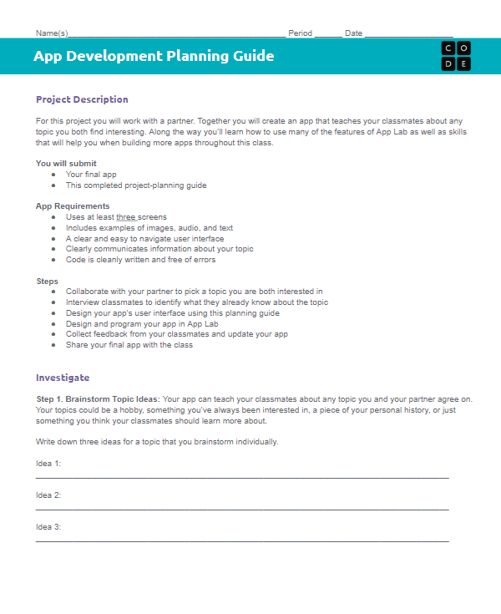
Unit 3 Lesson 10 - Activity
Finish Your App
You should have:
App Development Planning Guide

