Slide 1
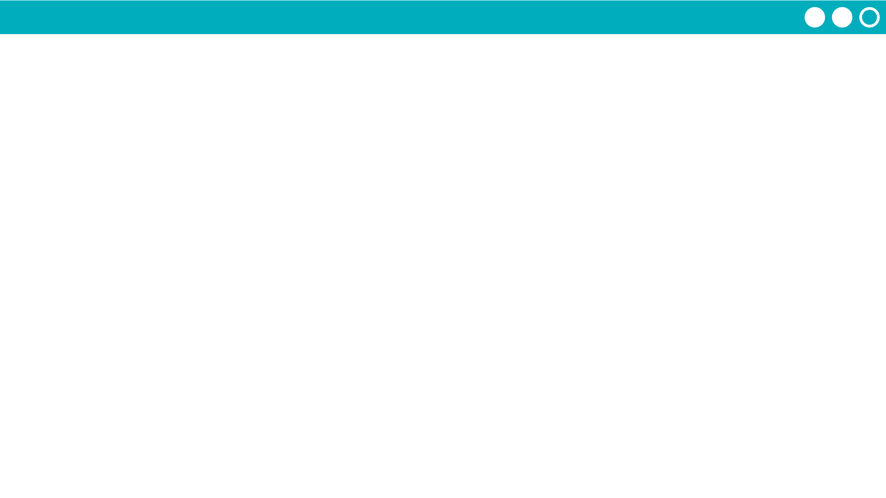
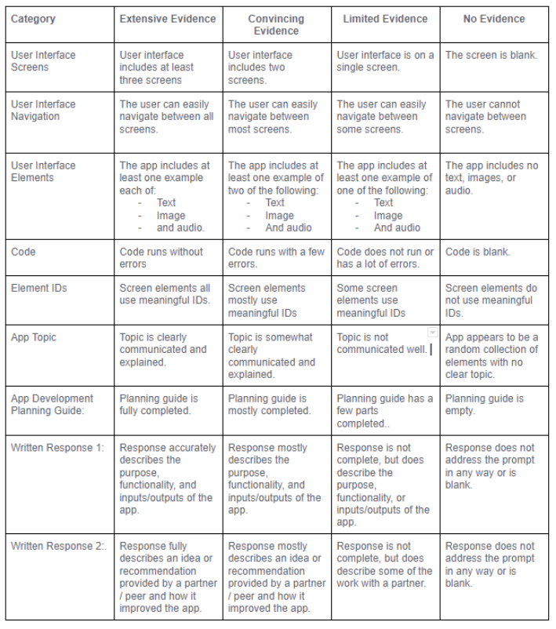
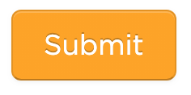
Unit 3 Lesson 10 - Activity
Step 8:
Finish your app!
Check the rubric!

