Slide 1

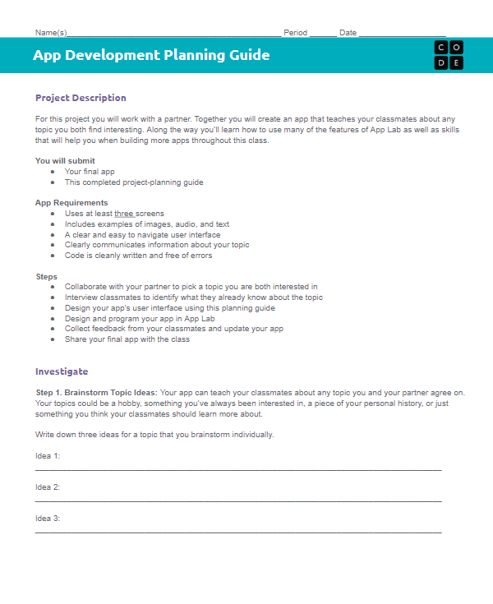
Unit 3 Lesson 10 - Wrap Up
Reflection:
Complete the reflection section of the Planning Guide before turning it in.

