Slide 1

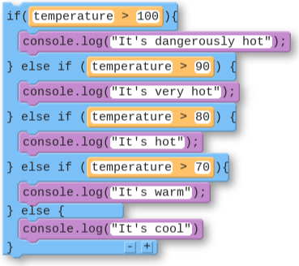
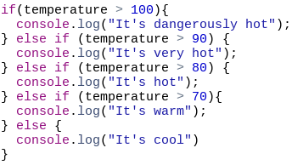
Unit 4 Lesson 6 - Wrap Up
Checking Multiple Conditions with If-Else-If
Name | Code (Block) | Code (Text)
Checking Multiple Conditions with If-Else-If

