Slide 1

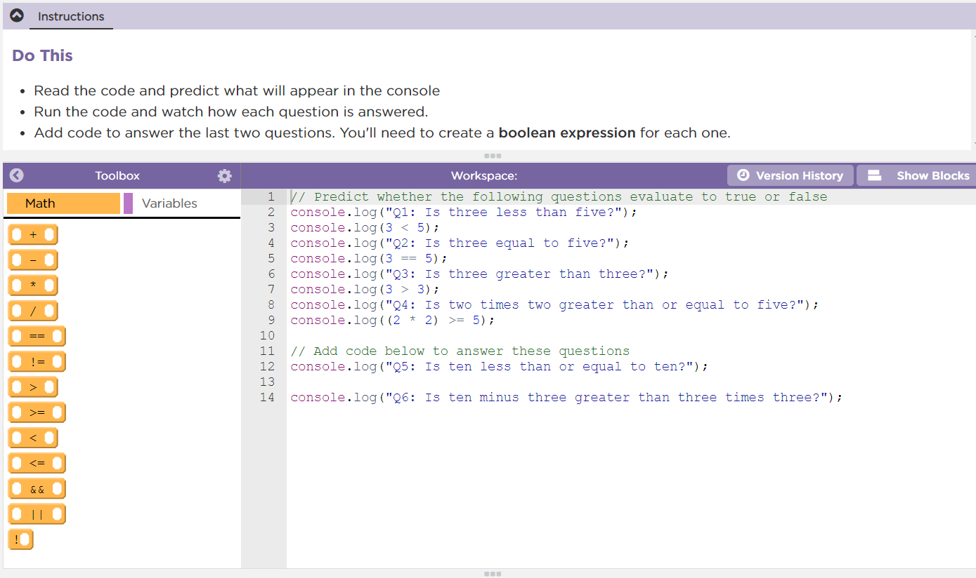
Unit 4 Lesson 7 - Activity
Conditionals Practice:
Do This:
Navigate to Lesson 7, Level 1 on Code Studio

