Slide 1

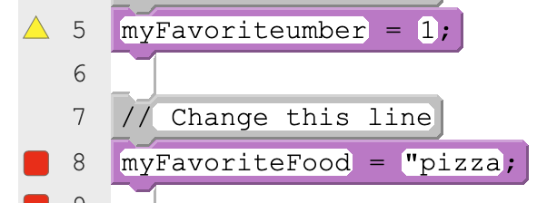
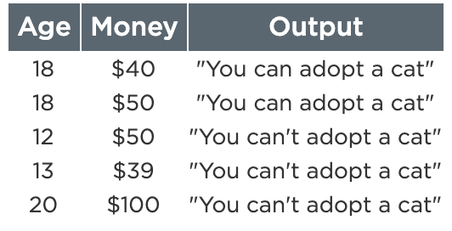
Unit 4 Lesson 7 - Activity
Specific Debugging Skill for the Day
Error Type | Example | How to Debug
Syntax Error: Your code doesn’t follow the rules of the programming language | Writing a variable name in quotes Using a variable that doesn’t exist | Check warnings and errors
Logic Error: Your code follows the rules of the programming language but doesn’t do what you intend | Writing if-else-if statements in the wrong order Updating the property of the wrong element | Test your code
Practice checking for both syntax errors and logic errors in your programs.

