Slide 1
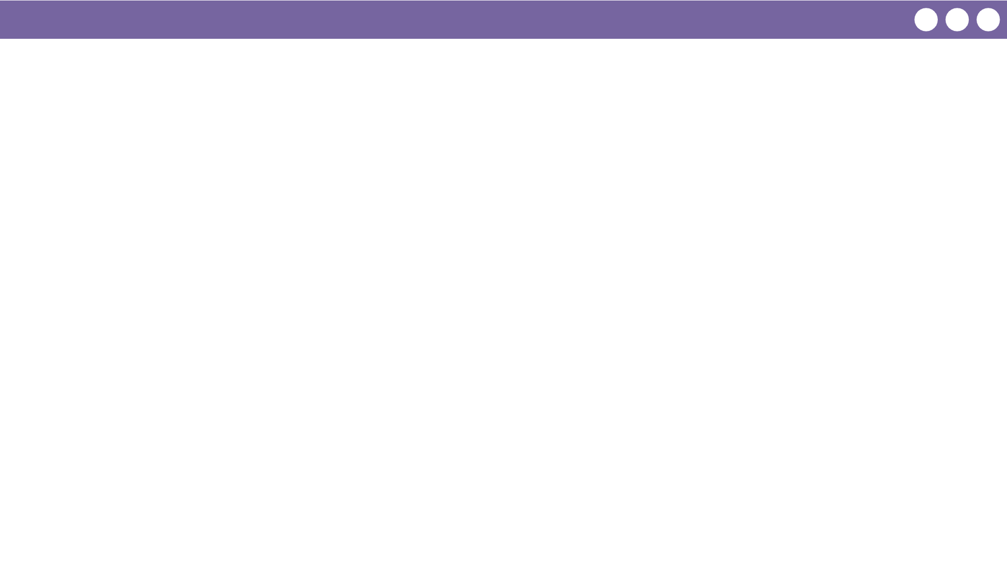
Unit 4 Lesson 7 - Wrap Up
Prompt:
What aspects of working with conditionals do you feel like clicked today?
What do you still feel like you have trouble with?

