Slide 1
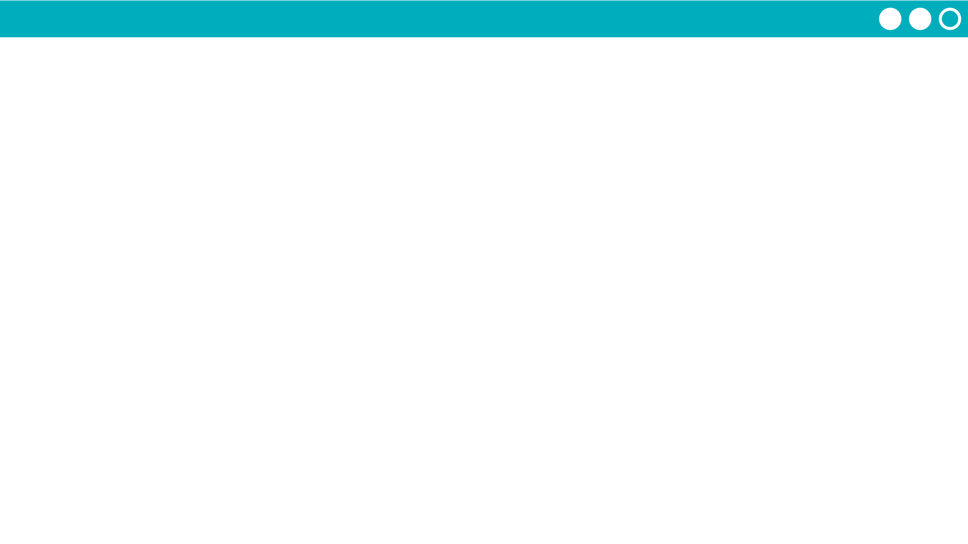
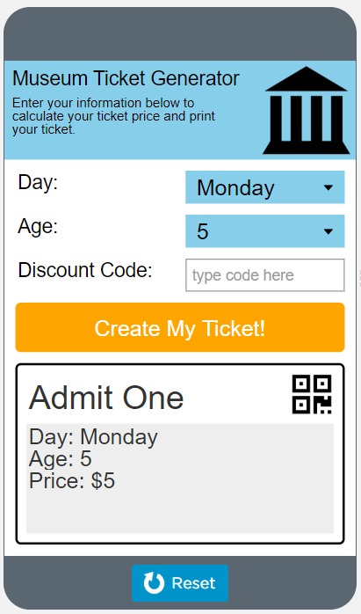

Unit 4 Lesson 8 - Activity
Conditionals Make:
Museum Ticket Generator
Do This:
Navigate to Lesson 8, Level 1 on Code Studio

