Slide 1
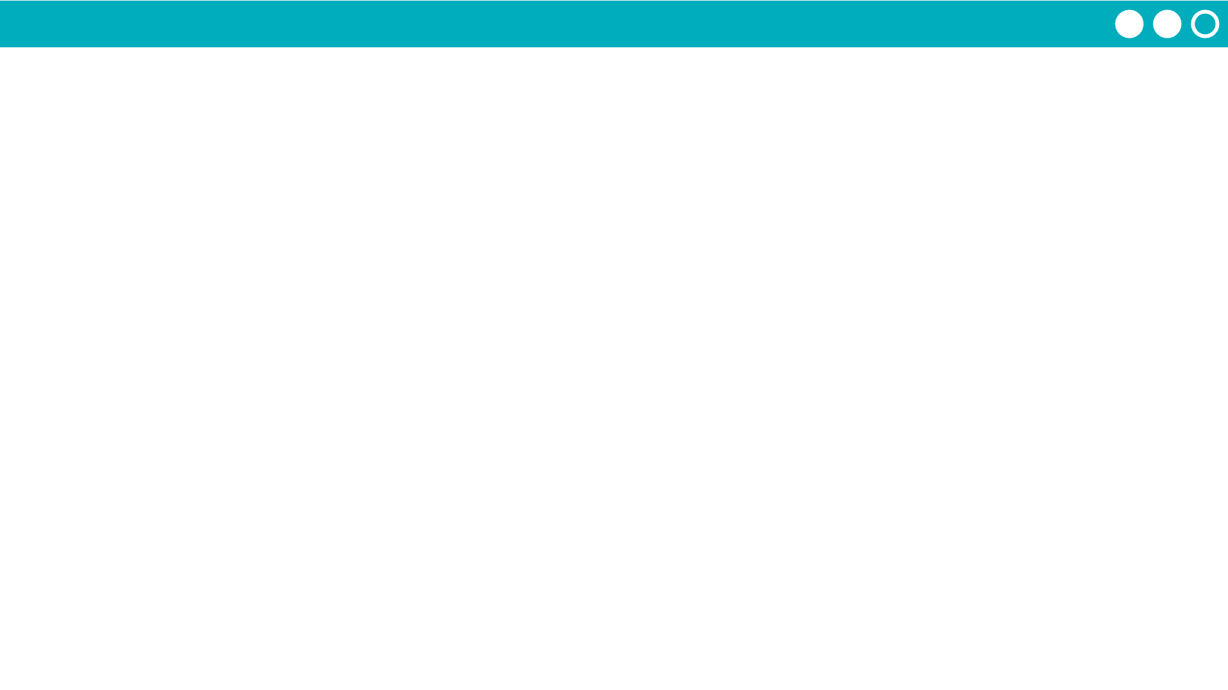
Unit 4 Lesson 8 - Activity
Step 1 - Try the app
Try making tickets for different combinations of inputs.
Make a ticket for a weekend.
Make a ticket for a weekday (Monday - Friday) and someone 18 or younger.
Try the discount code "FREEFRIDAY" on a Friday.
Discuss with a Partner
What variables would you need to program this app?
Where does this app use conditionals (if-statements)?

