Slide 1
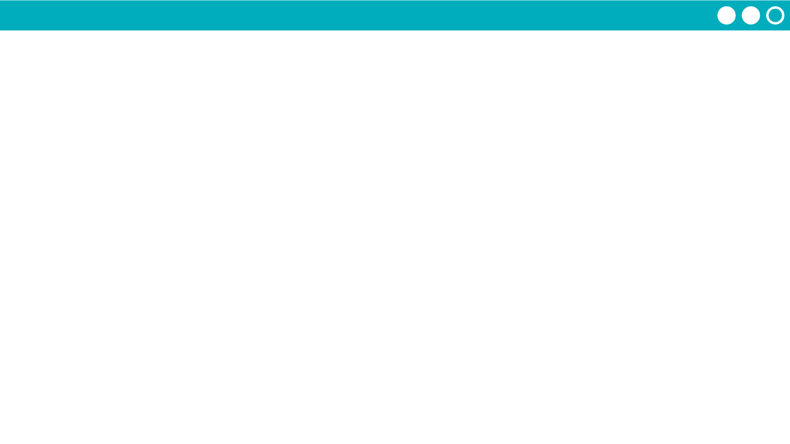
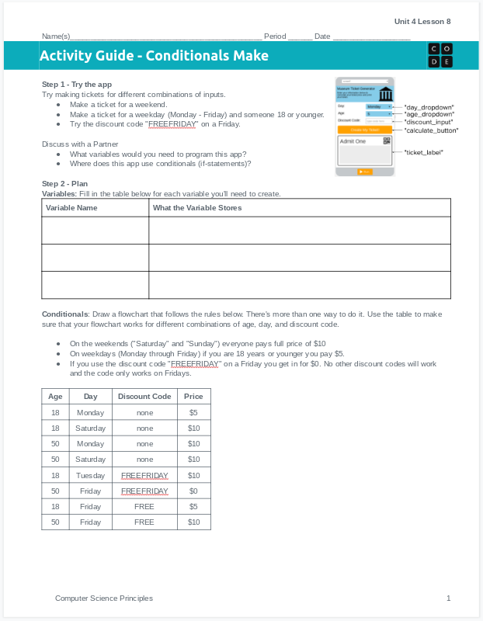
Unit 4 Lesson 11 - Activity
Do This: Make the Museum Ticket Generator!
Use the activity guide to plan out your code, including the variables you'll create and a flowchart of the conditional statement you'll need to write.
Step 3 includes steps you can follow to build the app, or you can use your own process.

