Slide 1
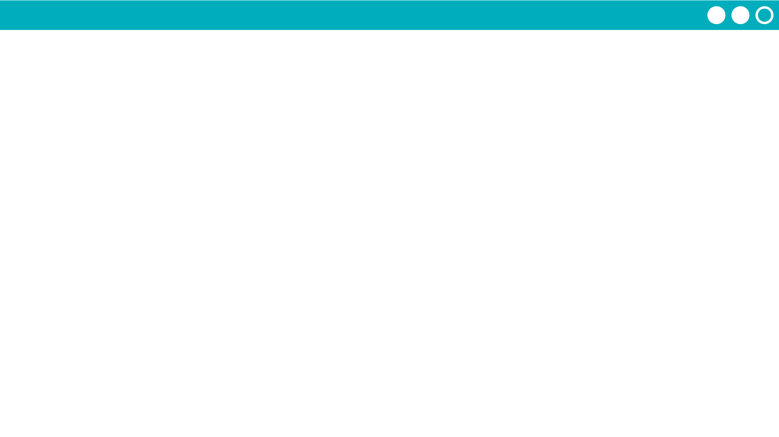
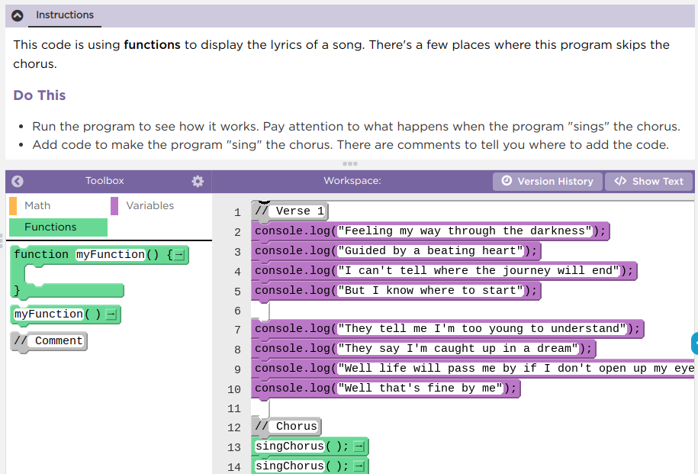
Unit 4 Lesson 9 - Activity
Functions Explore / Investigate
Do This:
Navigate to Lesson 9, Level 1 on Code Studio

