Slide 1
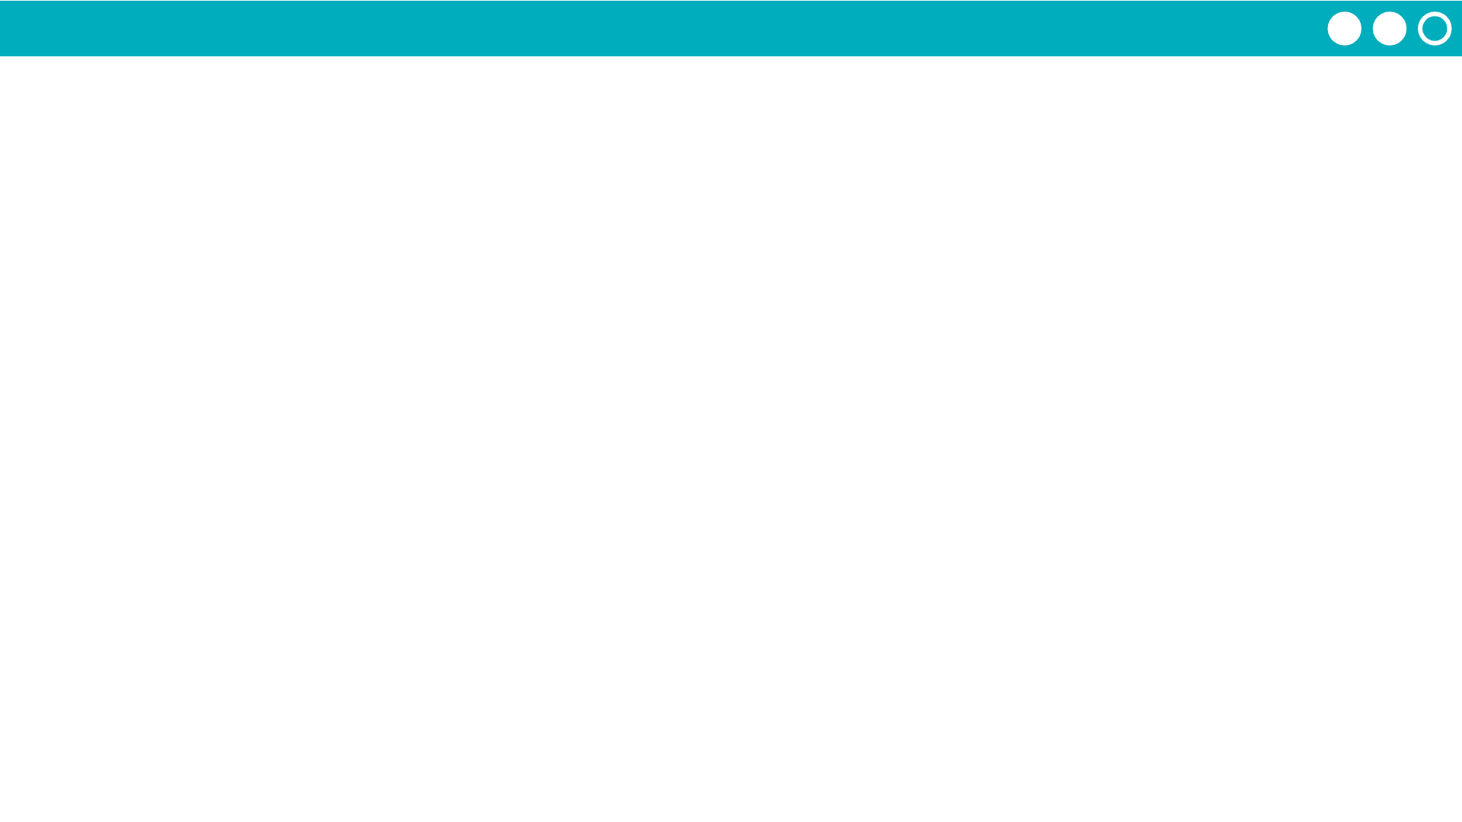
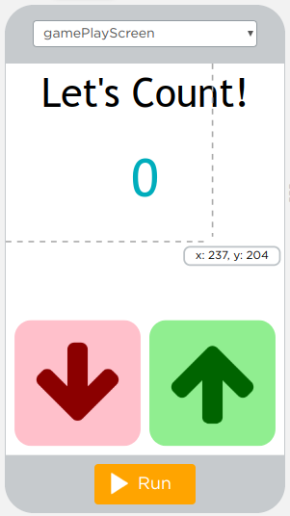
Unit 4 Lesson 9 - Activity
Level 3
On what line(s) is the updateScreen functions being declared?
On what lines is the updateScreen function being called?
How does the updateScreen function make the program easier to write and understand?

