Slide 1
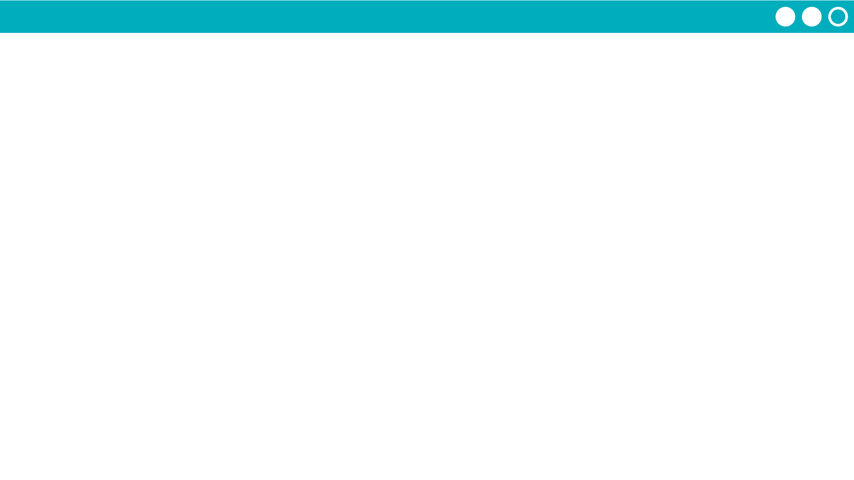
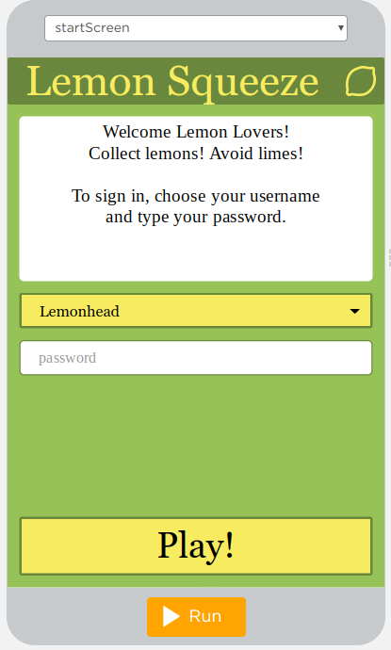
Unit 4 Lesson 9 - Activity
Level 4
How does the newly added updateScreen function help keep your code better organized or reduce the amount of repeated code?

