Slide 1

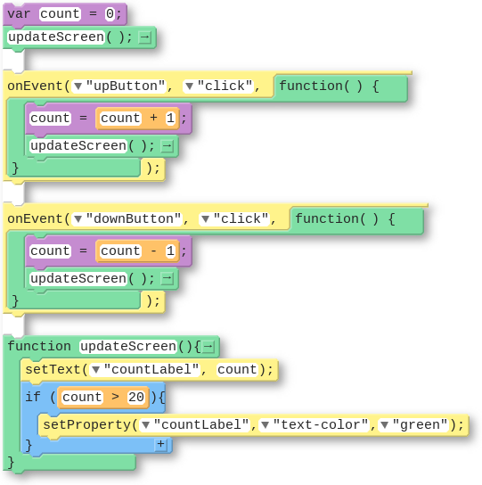
Unit 4 Lesson 9 - Wrap Up
The updateScreen() Pattern
Code (Block) | Code (Text)
 | var count = 0; updateScreen(); onEvent(“upButton”, “click”, function(){ count = count + 1; updateScreen(); }); onEvent(“downButton”, “click”, function(){ count = count - 1; updateScreen(); }); function updateScreen(){ setText(“countLabel”, count); if(count > 20){ setProperty(“countLabel”, “text-color”, “green”); } }

