Slide 1
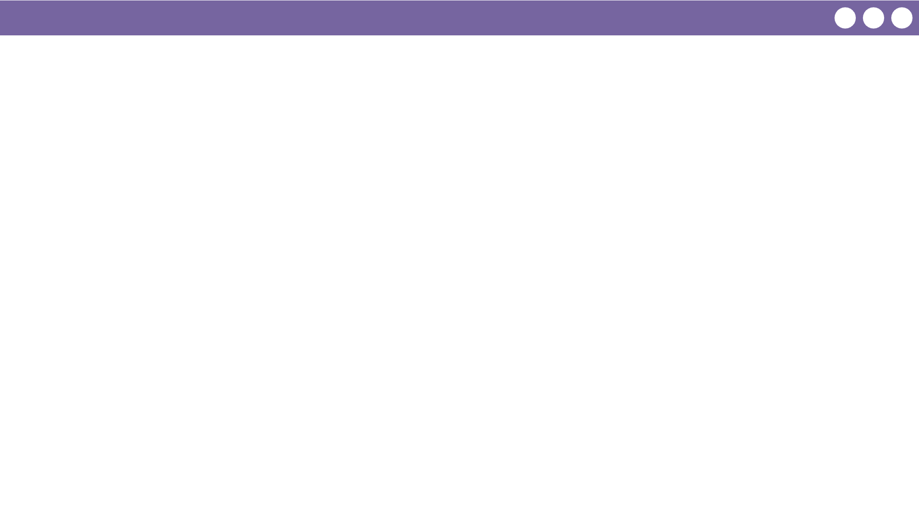
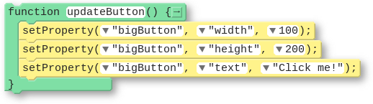

Unit 4 Lesson 9 - Wrap Up
Function: a named group of programming instructions. Also referred to as a “procedure”.
Function Call: a command that executes the code within a function

