Slide 1
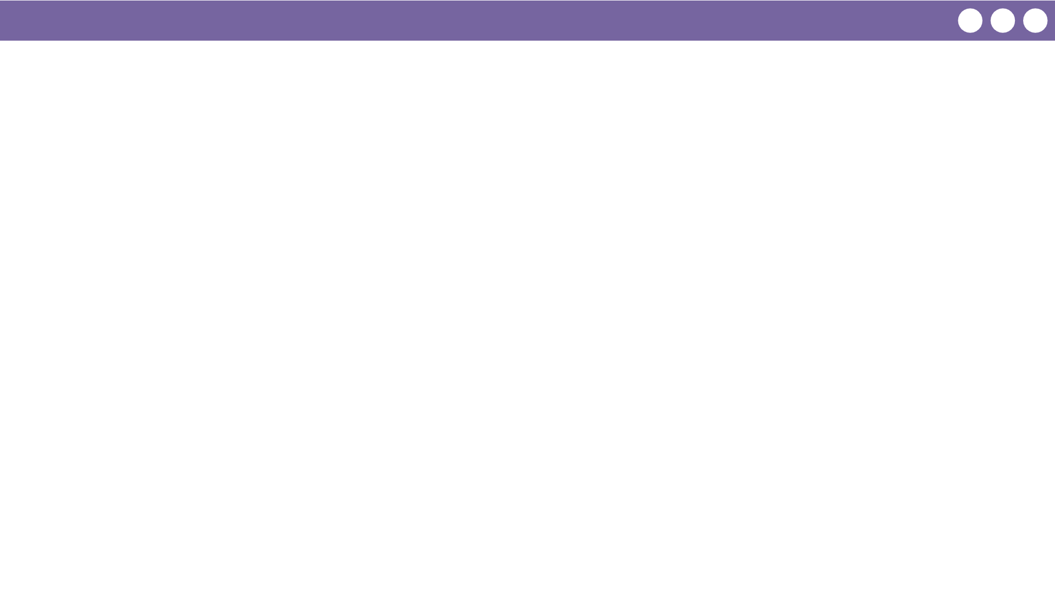
Unit 4 Lesson 9 - Wrap Up
Prompt:
Reflecting on today's lesson about functions:
What did you learn?
What are you uncertain about?

