Slide 1
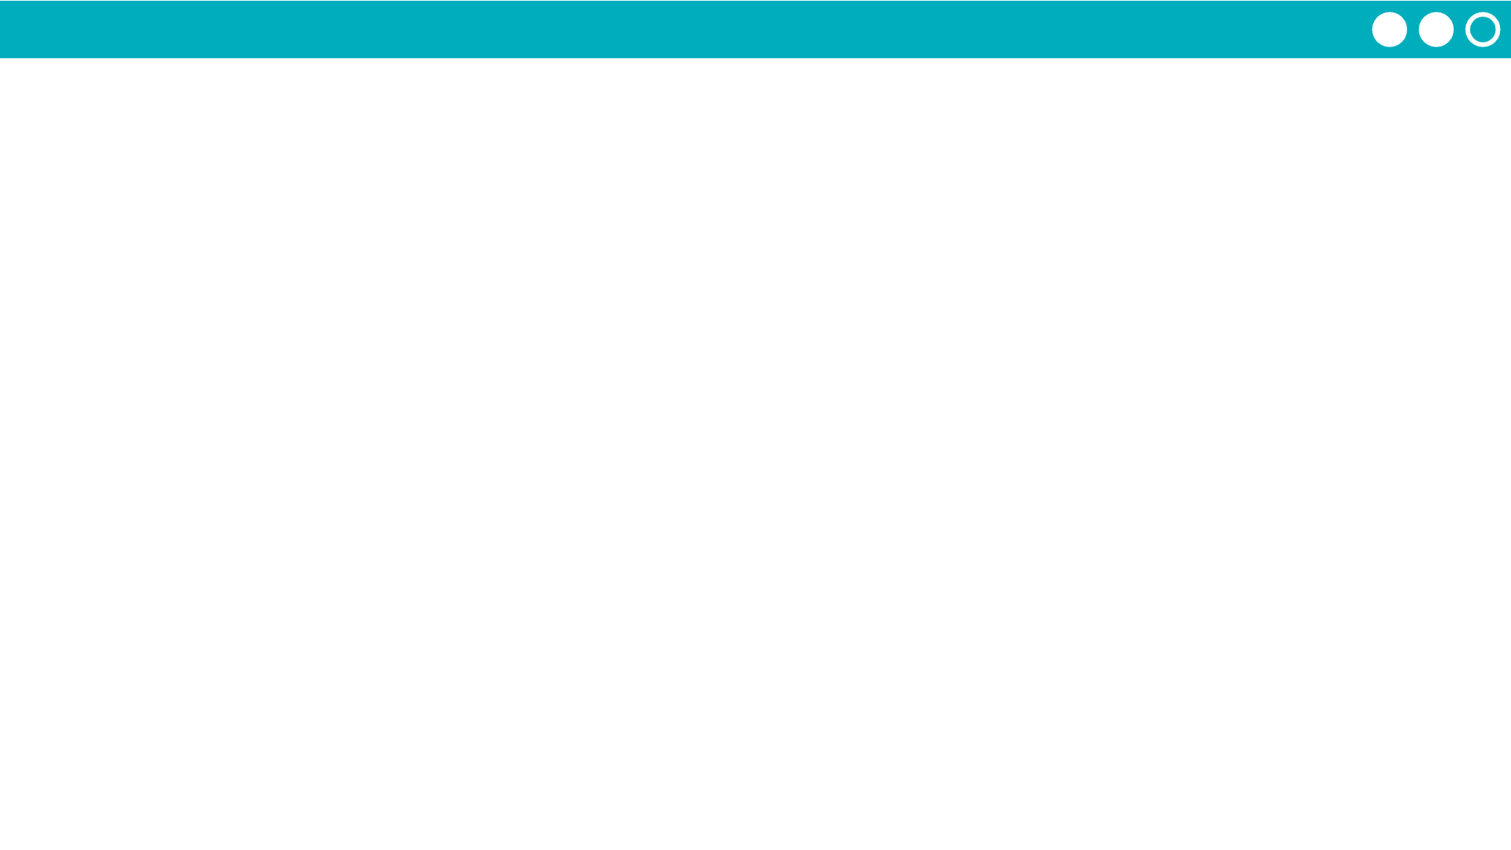
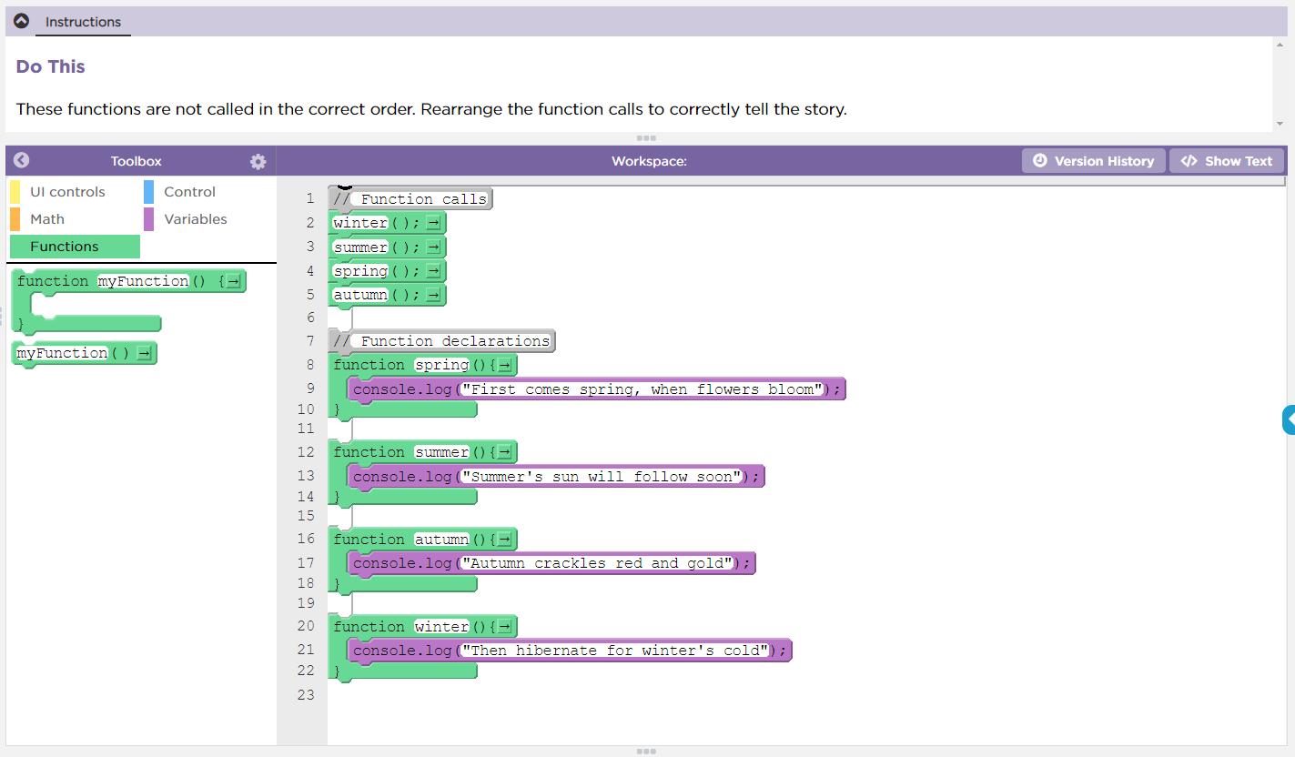

Unit 4 Lesson 10 - Activity
Functions Practice
Do This:
Navigate to Lesson 10, Level 1 on Code Studio

