Slide 1

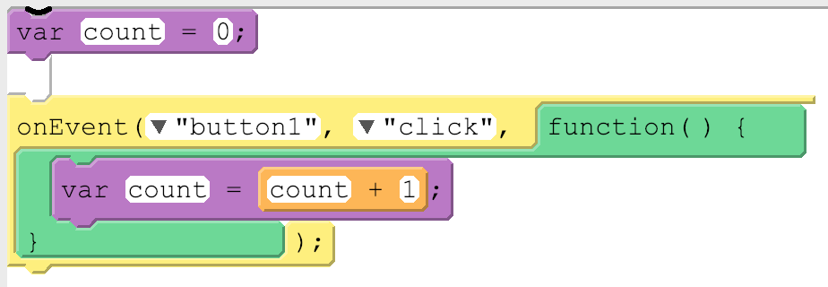
Unit 4 Lesson 10 - Activity
Avoiding Local Variables and Debugging
Local variables will eventually be useful but for now they're most likely to just be confusing. The biggest issue you'll fun into right now with local variables is accidentally using var inside of an onEvent() or function. Here's what the code usually looks like:
This code is pretty confusing. While it looks like there's only one variable being used, it actually has two variables, one local and one global, and they're both named count! Changing the value on one will have no impact on the other. This can cause unexpected behavior in your code and it can get tricky to debug.
The best way to avoid these issues is to make sure for now that you're not using var inside of an onEvent() or function. If you run into a tricky debugging problem, check if you're accidentally creating a local variable.

