Slide 1
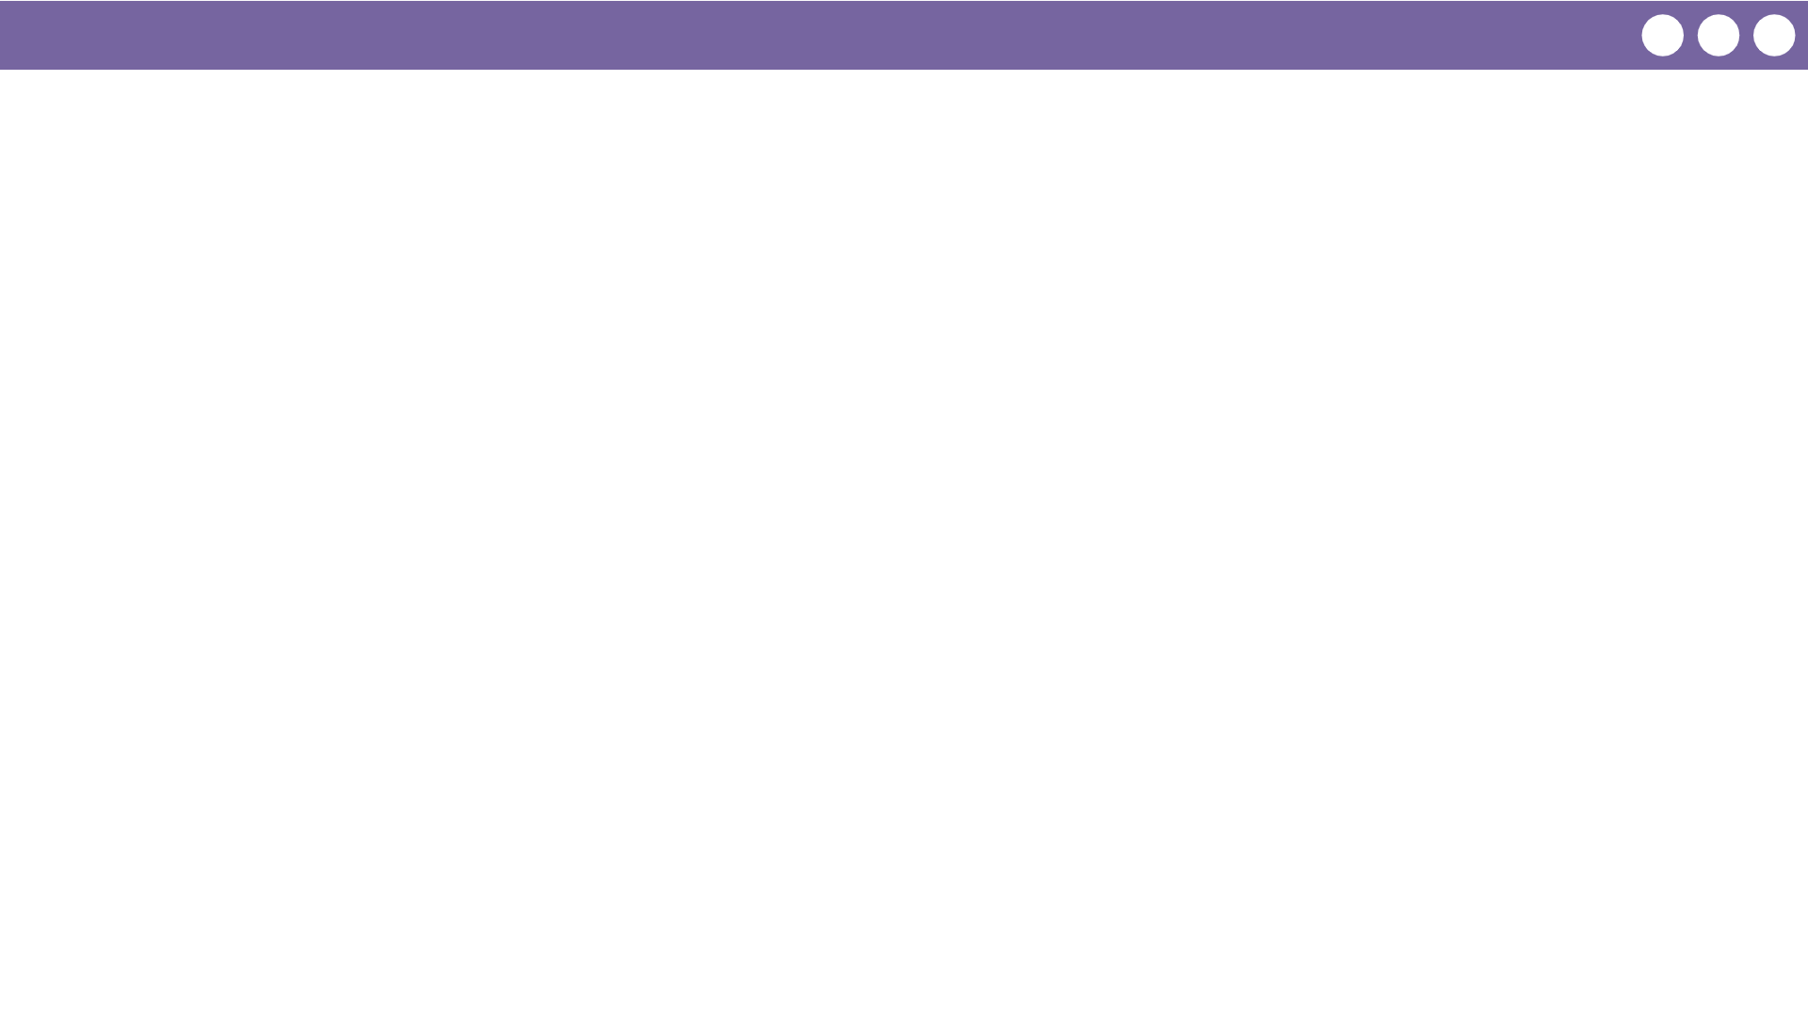
Unit 4 Lesson 10 - Wrap Up
Prompt:
What aspects of working with functions clicked today?
What do you still feel like you have trouble with?

