Slide 1
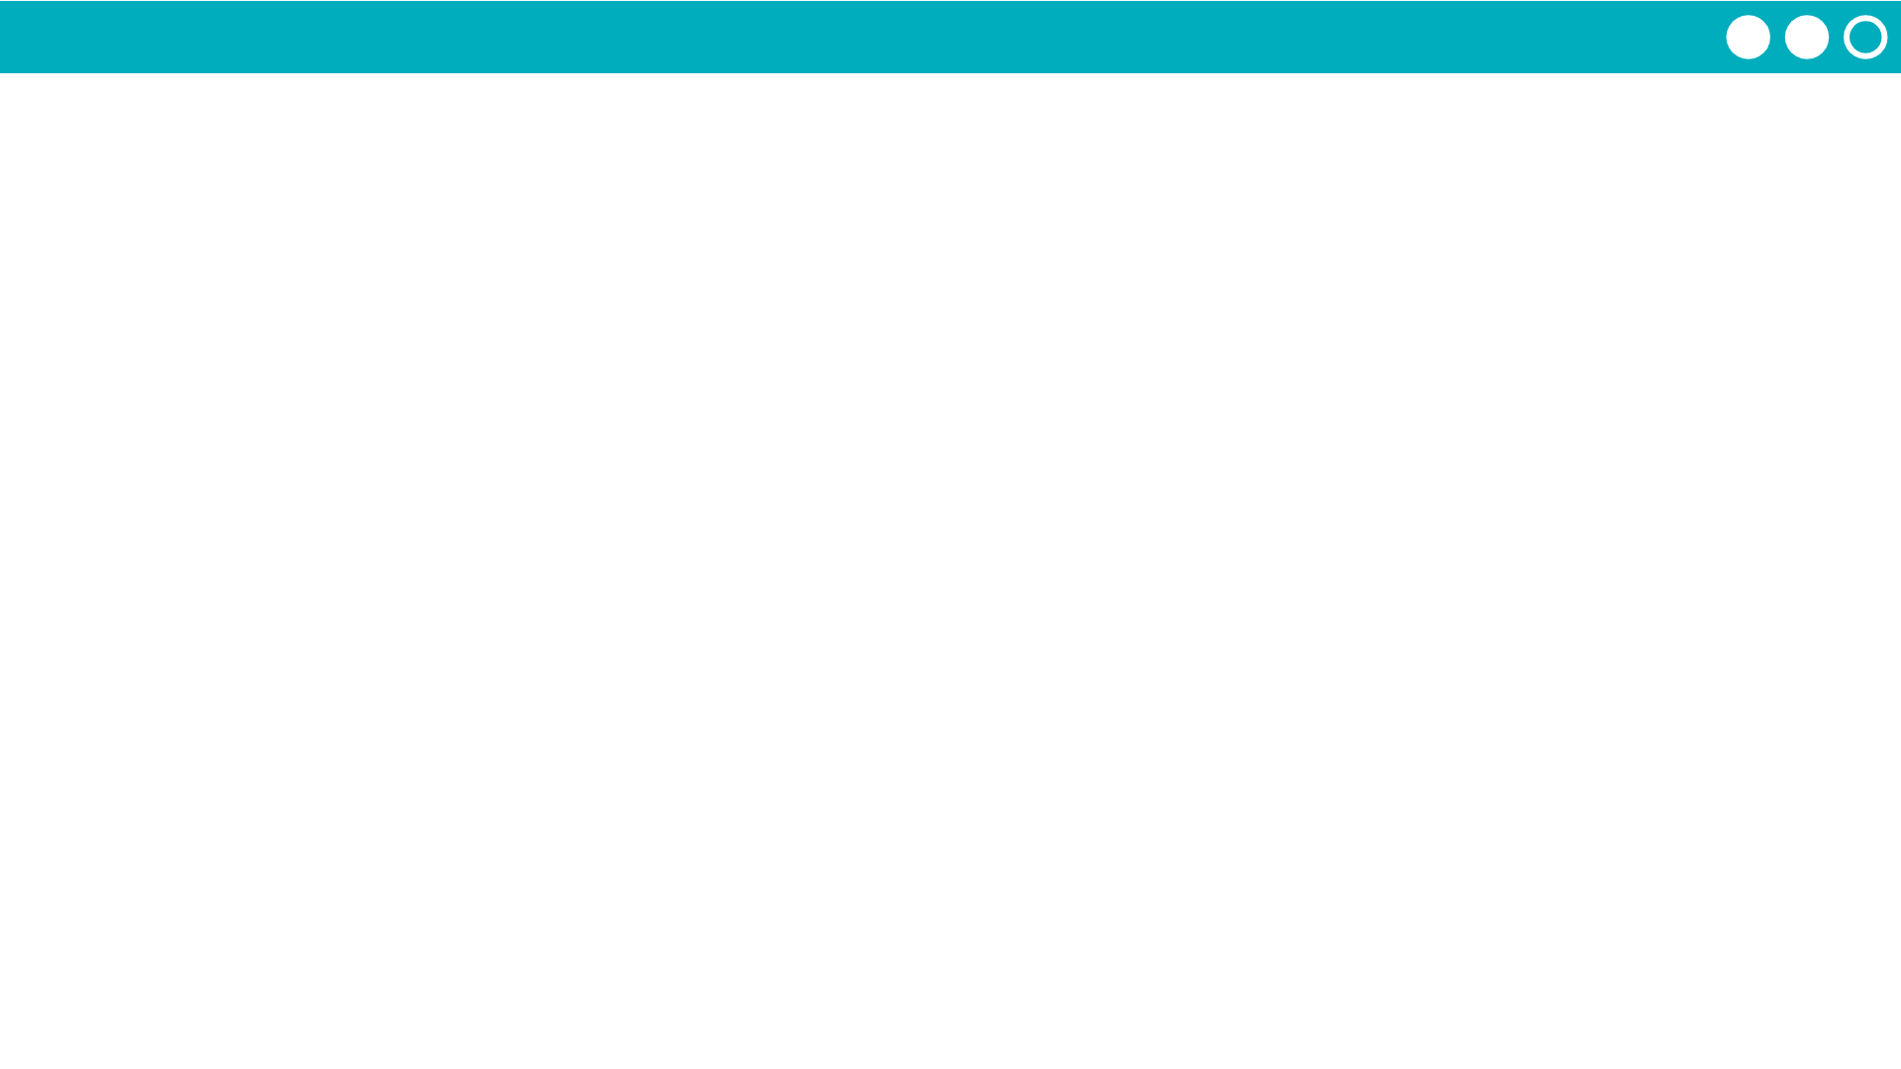
Unit 4 Lesson 1 - Activity
Let’s start writing programs that control our variables.
We’re going to stop using stickies but will highlight strings and numbers to help you remember the difference.

