Slide 1
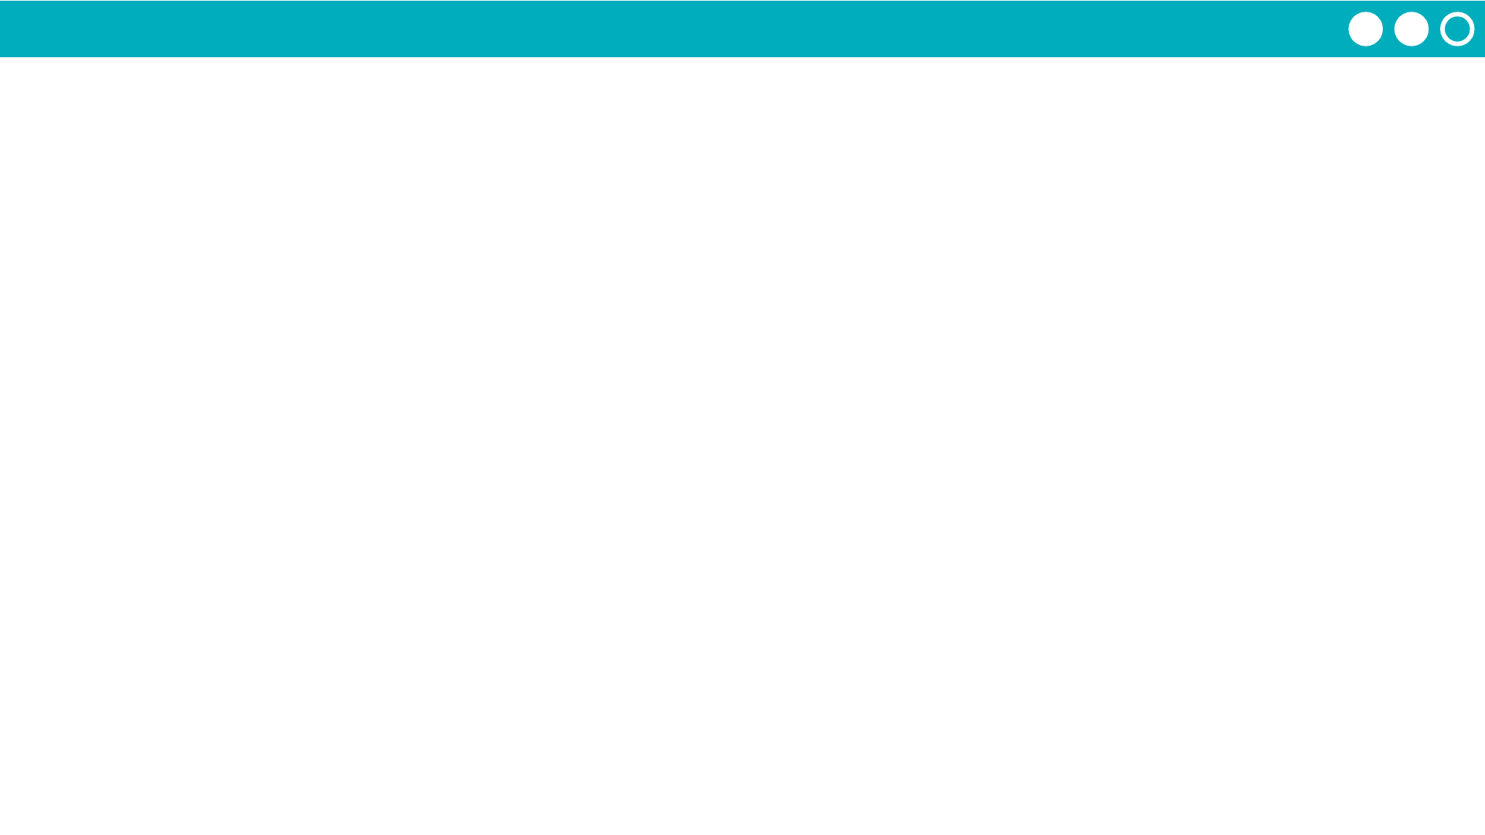
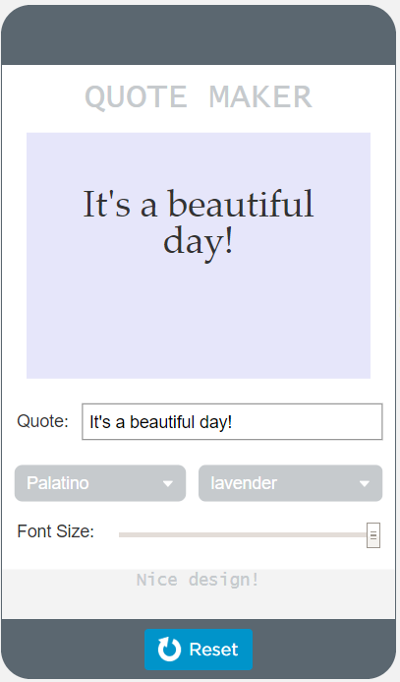

Unit 4 Lesson 11 - Activity
Functions Make:
Quote Maker App
Do This:
Navigate to Lesson 11, Level 1 on Code Studio

