Slide 1

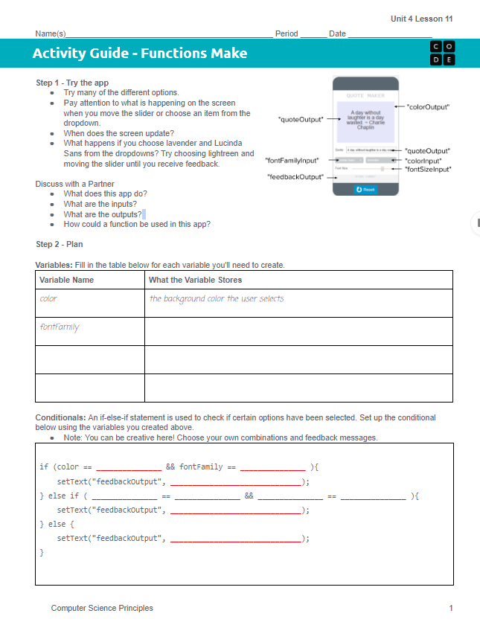
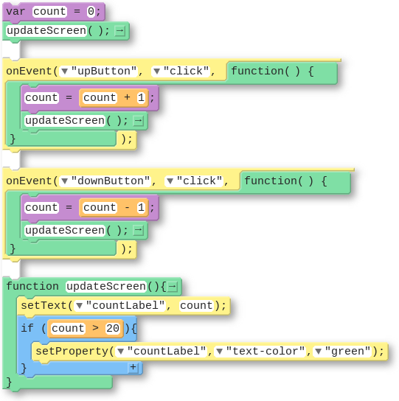
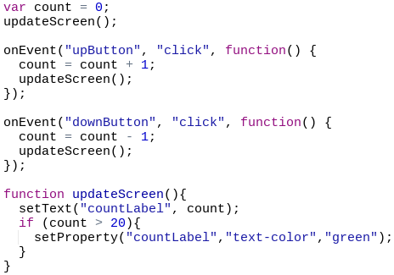
Unit 4 Lesson 11 - Activity
Do This: Make the Quote Maker!
The updateScreen() Pattern

