Slide 1

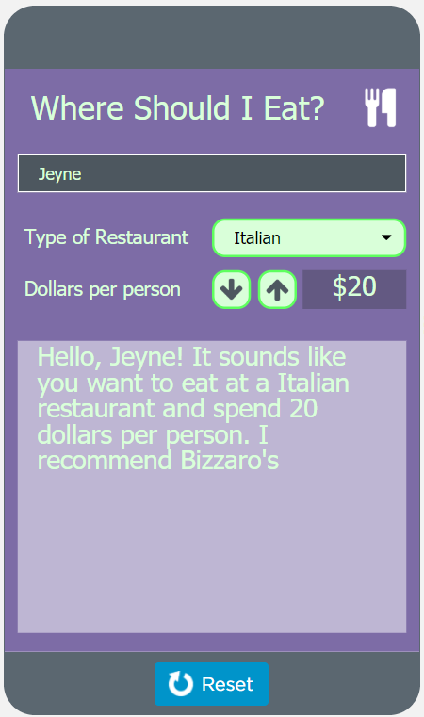
Unit 4 Lesson 12 - Activity
Level 1: Sample App #1
What does this app do?
What are the inputs?
What are the outputs?
What variables do you think would be necessary for this app to work?
What kinds of conditional logic do you think are necessary to make it work?
How could a function be used in this app?

