Slide 1

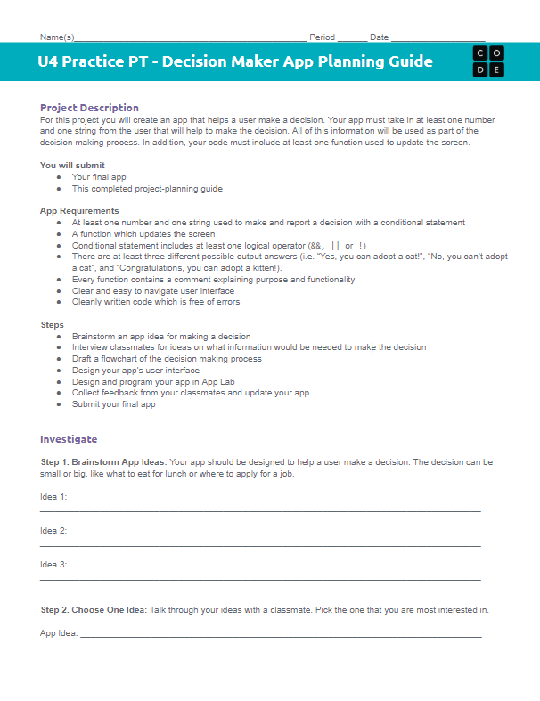

Unit 4 Lesson 12 - Activity
Practice PT: Plan the Decision Maker App
You should have:
Practice PT Decision Maker App Planning Guide
Pen/Pencil

