Slide 1

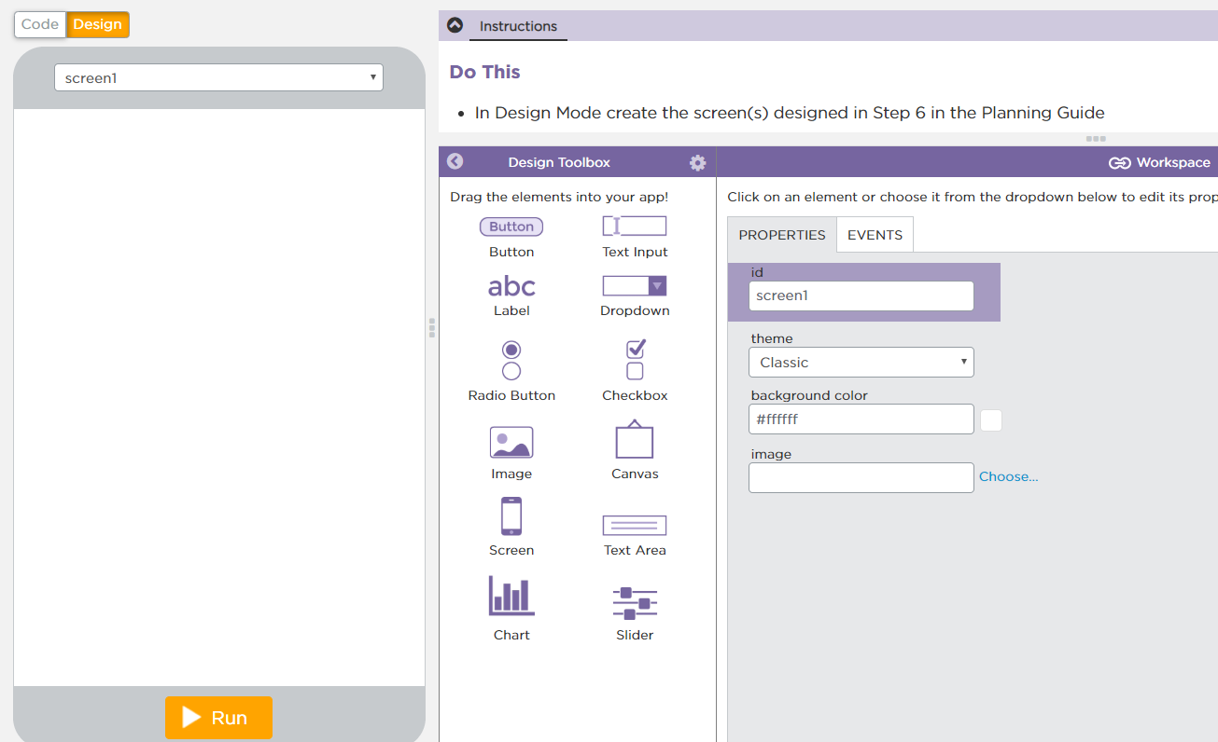
Unit 4 Lesson 13 - Activity
Build the Decision Maker App
Do This:
Navigate to Lesson 13, Level 1 on Code Studio

