Slide 1

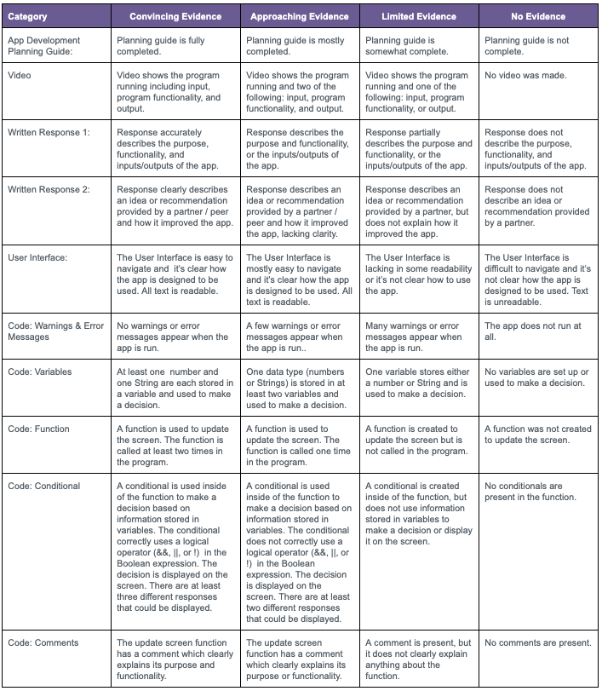
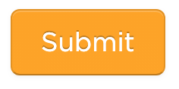
Unit 4 Lesson 14 - Activity
Finish Your App
Do This:
Complete Steps 9-11:
  Pick Improvements (Planning Guide)
  Complete Your App (Level 1)
  Record a video of you using your app
Check the rubric on Level 2 before submitting!

