Slide 1

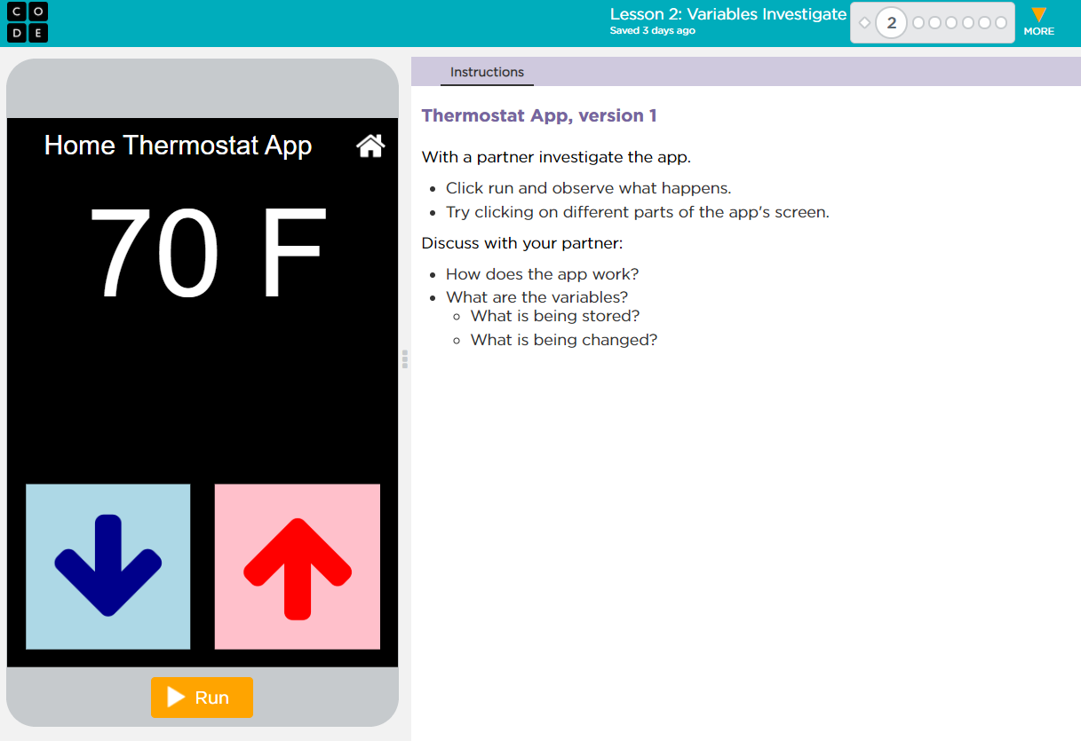

Unit 4 Lesson 2 - Activity
Variables Investigate

