Slide 1

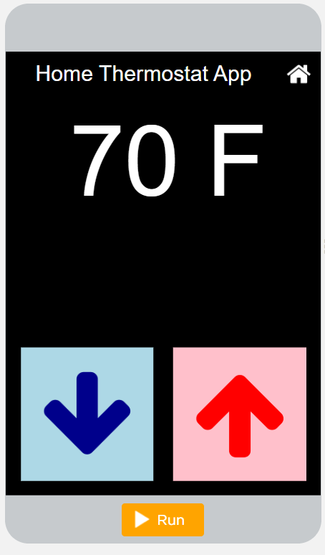
Unit 4 Lesson 2 - Activity
Level 1
Do This:
Run the app
Predict the information that is being stored in variables

