Slide 1
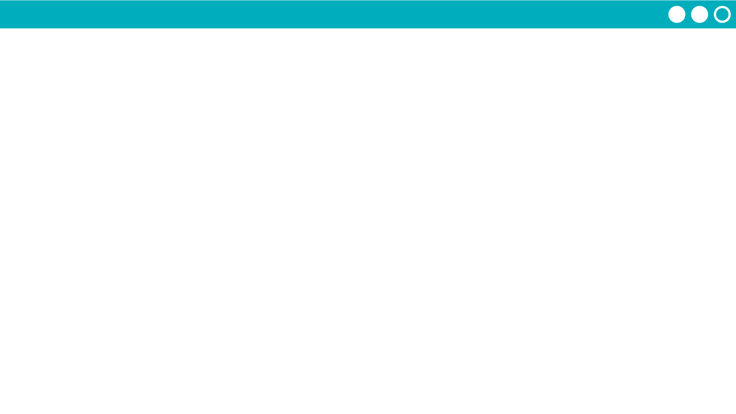
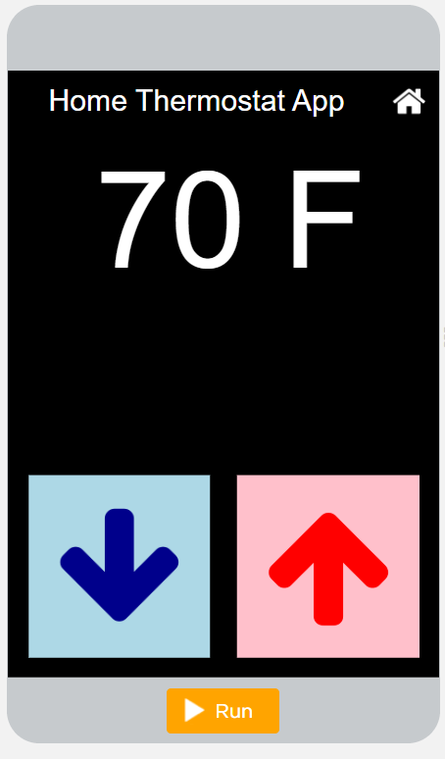
Unit 4 Lesson 2 - Activity
Level 2
Do This:
Read Code: Read the code for your assigned section making sure you understand how it works.
Explain Your Section: Make a group with partners who investigated the other section. Carefully explain how your section works line by line.

