Slide 1
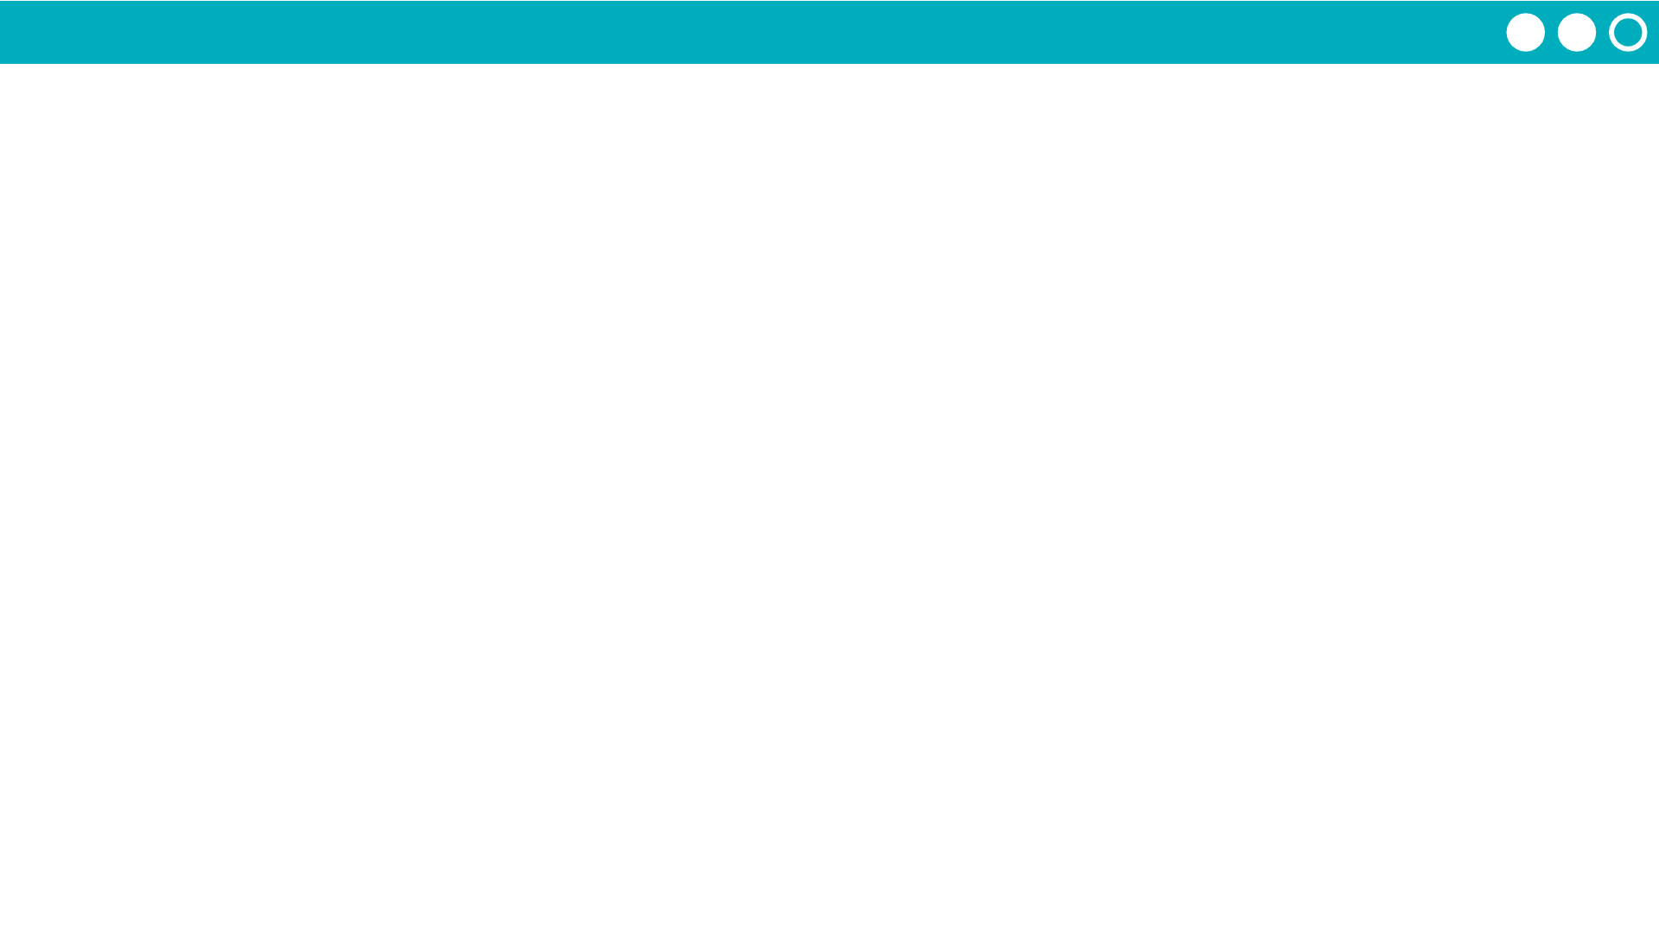
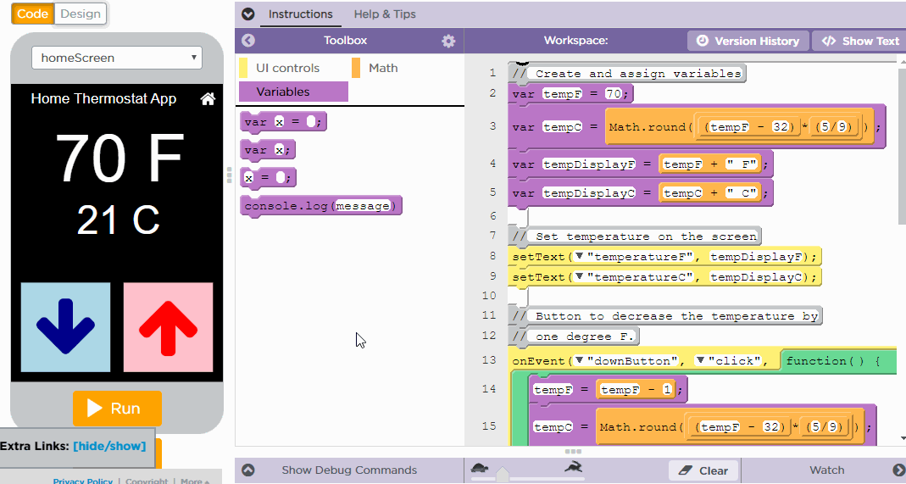
Unit 4 Lesson 2 - Activity
Adding a Watcher

