Slide 1

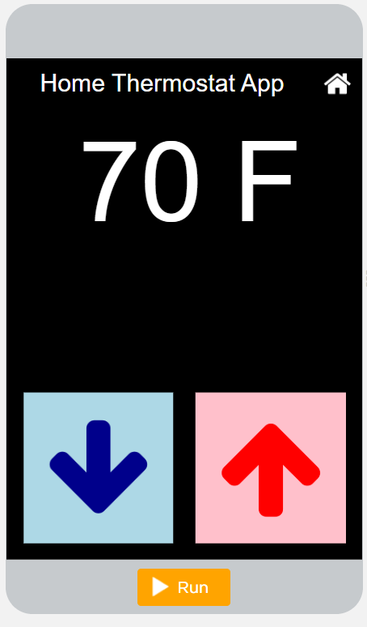
Unit 4 Lesson 2 - Activity
Level 2
Do This:
Modify: Change the degrees by two when the up and down arrow are clicked.

