Slide 1

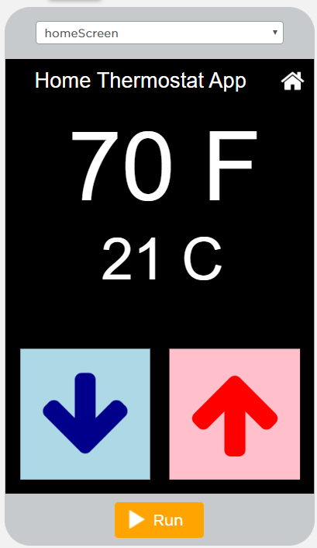
Unit 4 Lesson 2 - Activity
Level 3
Do This:
Run the app.
Discuss changes.
Find the Math.round command. Discuss with a partner how this command might work.
Modify: Change the code so that no space displays between the temperature and the unit descriptions ("F" or "C").

