Slide 1

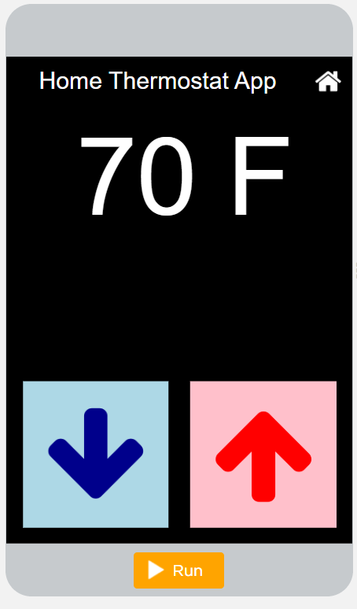
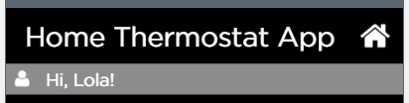
Unit 4 Lesson 2 - Activity
Level 5
Do This:
Read Code: Read the code and discuss with your partner what has changed and what has stayed the same.
Class Discussion: How does getText() work?
Modify: Add an explanation point "!" to the end of the string stored in userName so the following is displayed on the screen:

