Slide 1

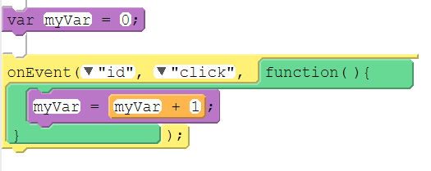
Unit 4 Lesson 2 - Activity
Counter Pattern with Event
Name | Code (Block) | Code (Text)
Counter Pattern with Event |  | var myVar = 0; onEvent("id", "click", function() { myVar = myVar + 1; });

