Slide 1

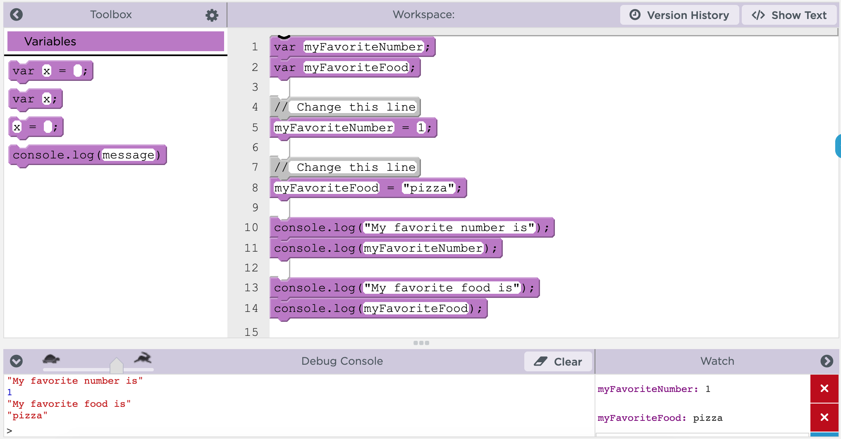
Unit 4 Lesson 3 - Activity
Specific Debugging Skills for the Day
1. Slow down code with the speed slider
2. Use console.log to get output
3. Use Watchers to see your variables change values

