Slide 1

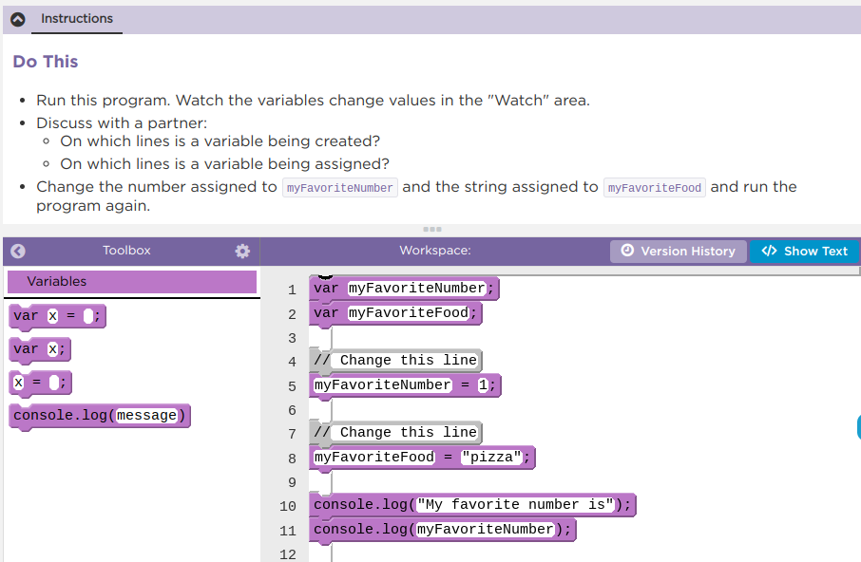
Unit 4 Lesson 3 - Activity
Variables Practice
Do This:
Navigate to Lesson 3, Level 1 on Code Studio
Complete Levels 1-7

