Slide 1

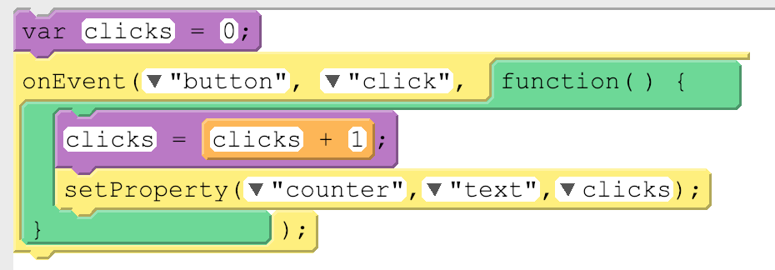
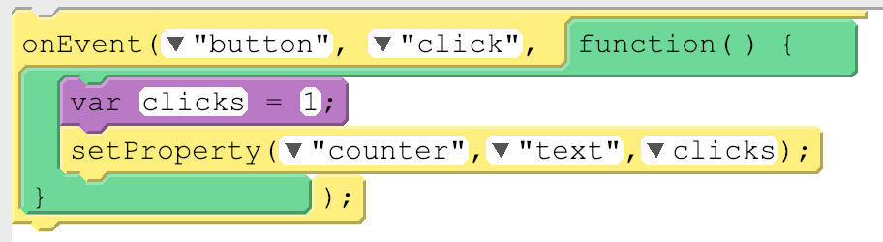
Unit 4 Lesson 3 - Activity
Global vs. Local Variables
There's two types of variables, global and local, and so far we've only used global variables. Here's the main difference between global and local variables.
Type of Variable | How It Works | How Created | Picture
Global | Permanent. Can be used anywhere in your code. | var used outside an onEvent()
Local | Temporary. Can be used only in the part of the code where it was created, like inside an onEvent(). Deleted once the onEvent() is done running. | var used inside an onEvent()

