Slide 1
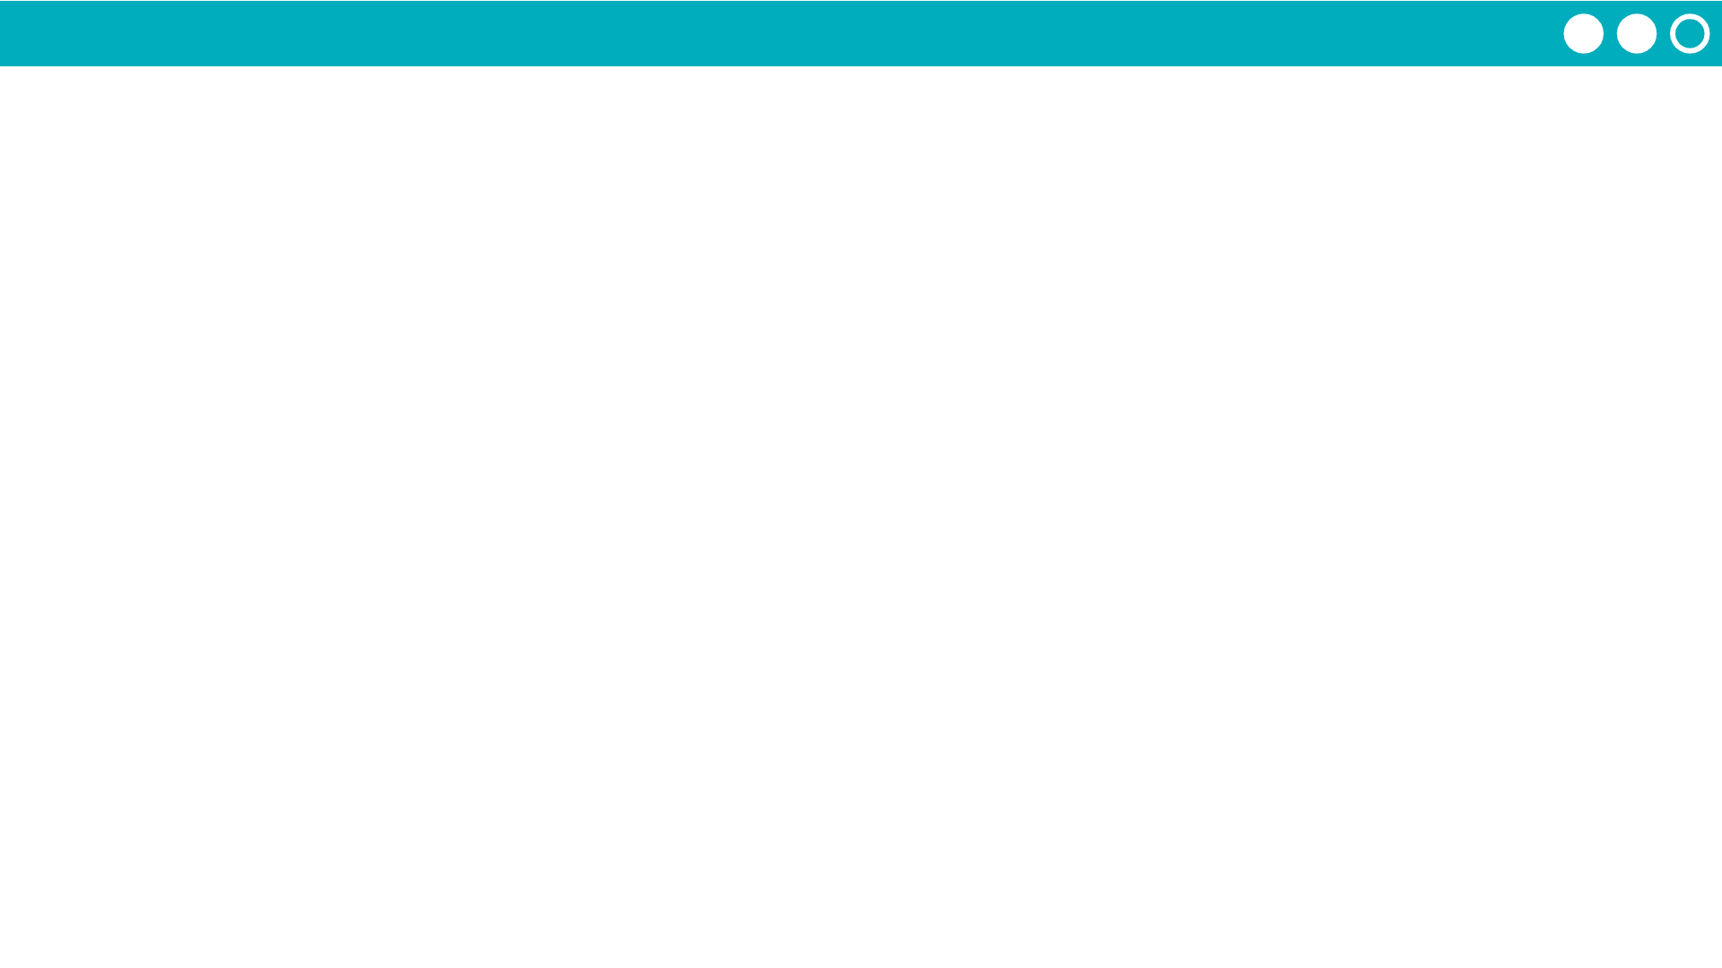
Unit 4 Lesson 3 - Activity
Do This:
Review Lesson 8
Finish Levels 9-10

