Slide 1
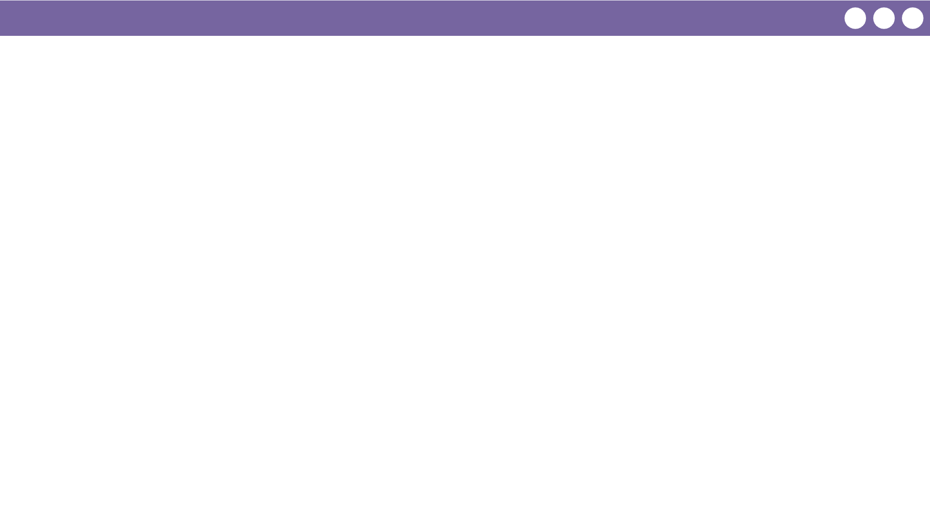
Unit 4 Lesson 3 - Wrap Up
Prompt:
What aspects of working with variables do you feel like clicked today? What do you still feel like you have trouble with?

