Slide 1

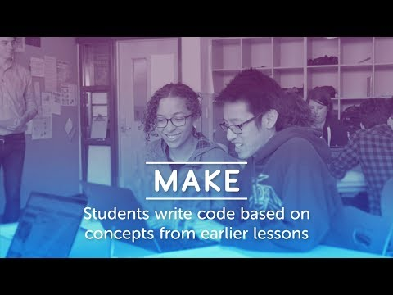
Unit 4 Lesson 4 - Set Up

