Slide 1

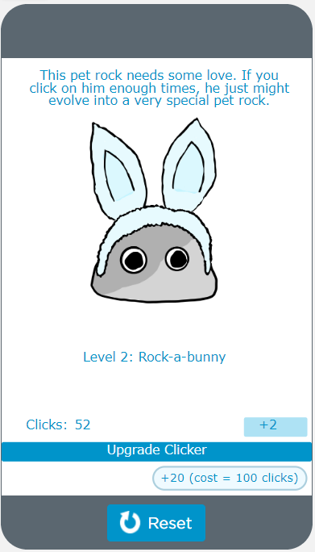

Unit 4 Lesson 1 - Warm Up
Do This:
Navigate to Lesson 1, Level 1 on Code Studio

