Slide 1
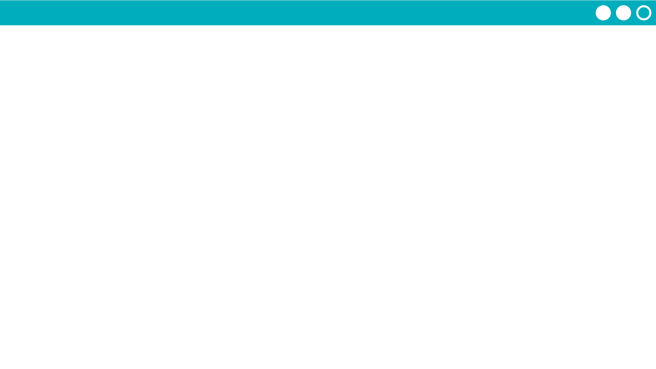
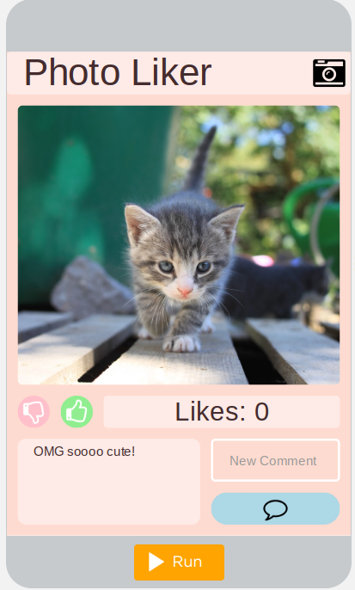

Unit 4 Lesson 4 - Activity
Variables Make:
Photo Liker
Do This:
Navigate to Lesson 4, Level 1 on Code Studio

