Slide 1

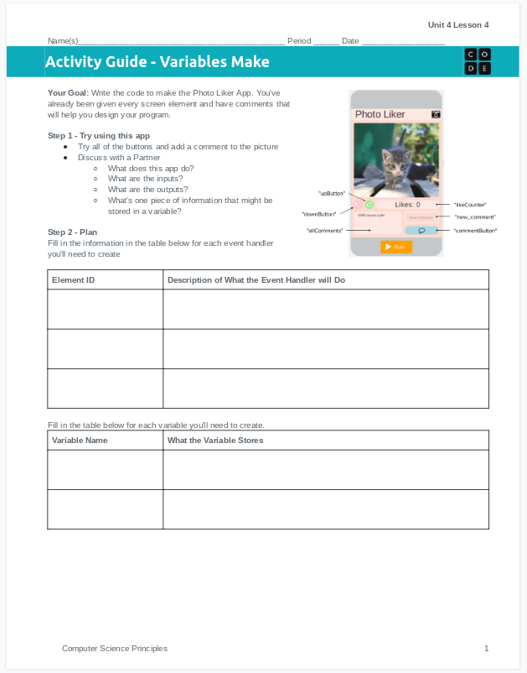
Unit 4 Lesson 11 - Activity
Do This: Make the Photo Liker!
Use the activity guide to plan out your code, including the event handlers and variables you'll need to create.
Step 3 includes steps you can follow to build the app, or you can use your own process.

