Slide 1

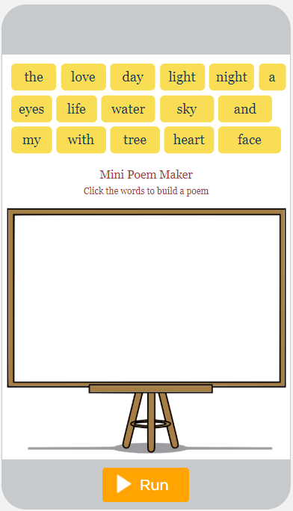
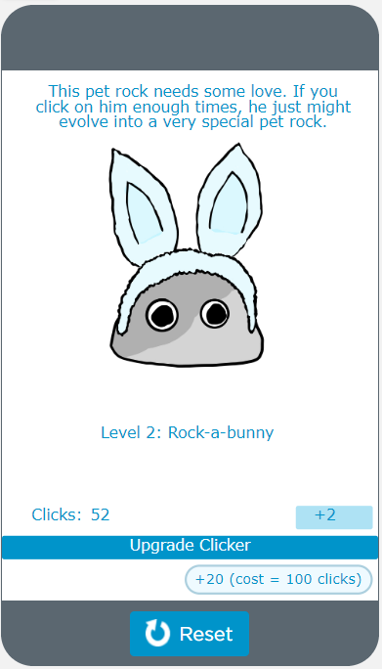
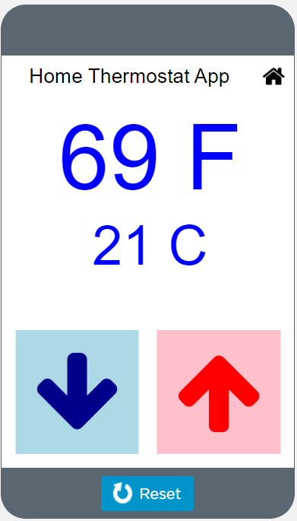
Unit 4 Lesson 1 - Warm Up
Prompt:
These are samples of the kinds of apps you'll be able to build by the end of this unit. As you go through them, write down at least two examples where the app seems to be keeping track of a piece of information or using it to make a decision.

